Slide 1
Encoder-Decoder Models and Attention

Slide 2
Overview
We have explored recurrent neural networks along with some of their common use cases
Today we will introduce: encoder-decoder networks or sequence-to-sequence models

Slide 3
Neural Language Models and Generation Revisited

Slide 4
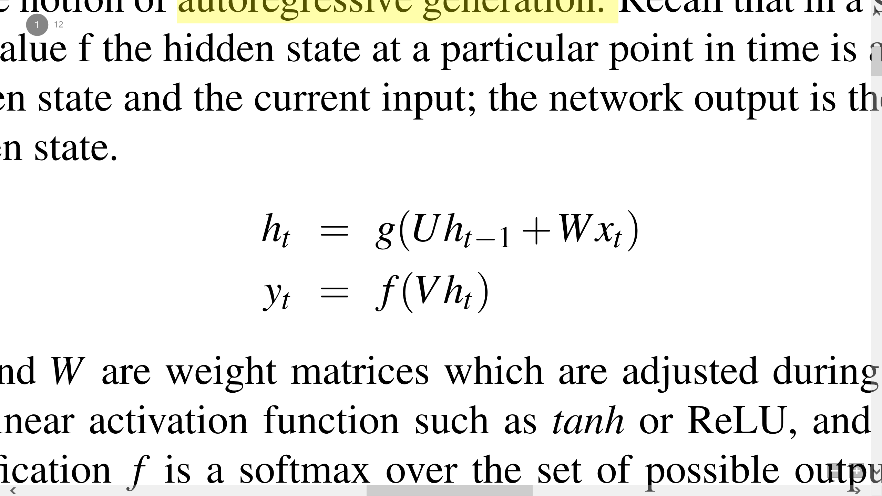
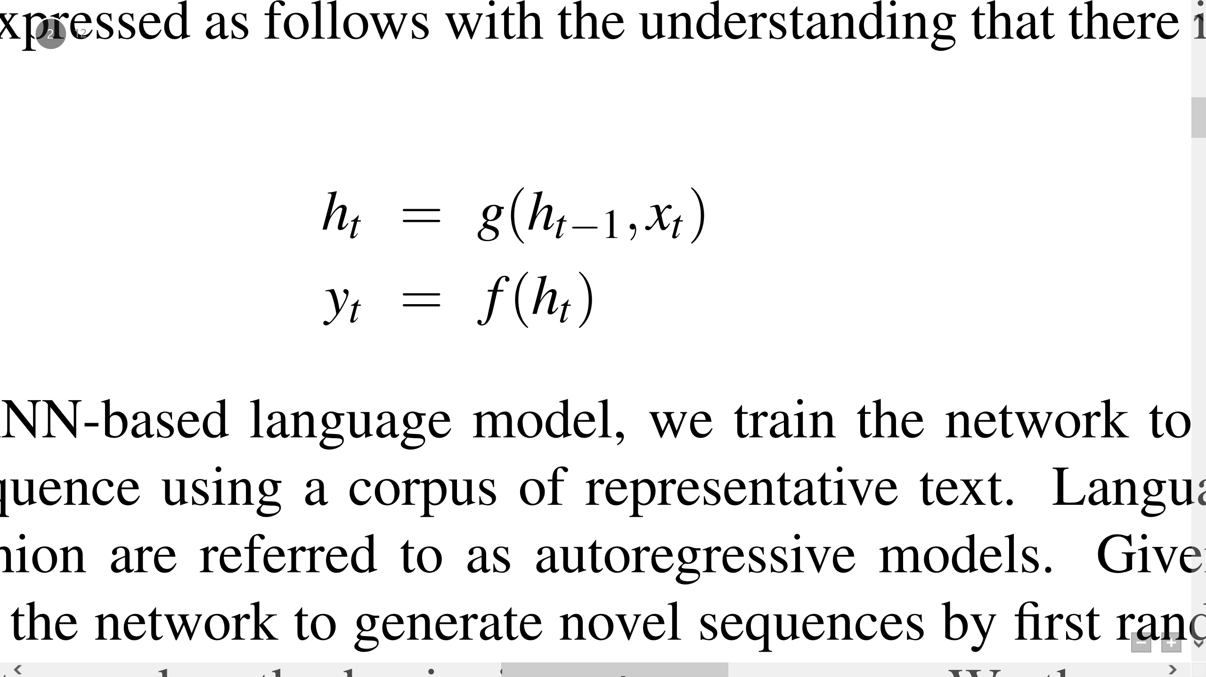
Review
In simple recurrent network:
The value f the hidden state at a particular point in time is a function of the previous hidden state and the current input
Express the equations for specific RNNs(LSTMs or GRUs):

Slide 5
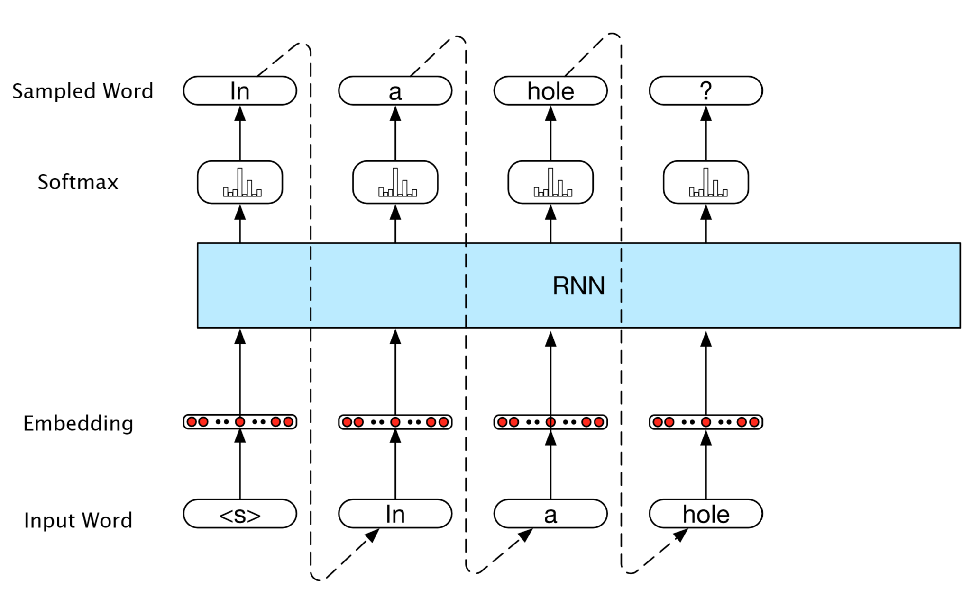
RNN-based language model
autoregressive generation

Slide 6
Variation of RNN-based LM
Consider a simple variation:
First pass a speciﬁed preﬁx through the language model using forward inference
Then generate using the ﬁnal hidden state of the preﬁx as the starting point.

Slide 7
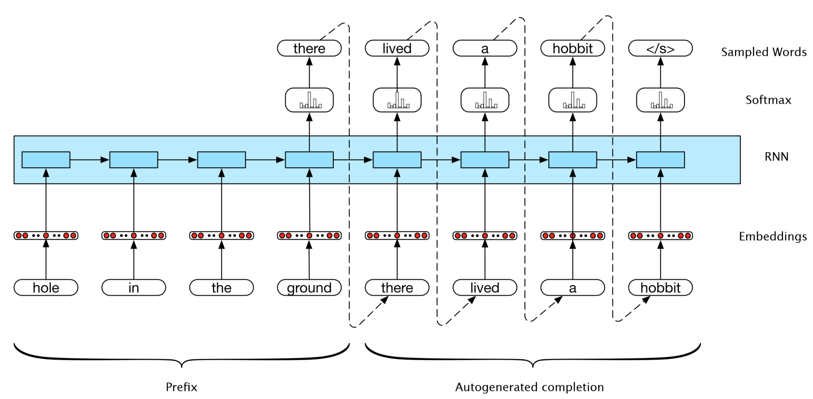
Variation of RNN-based LM
Process the provided prefix.
No outputs until the end.

Slide 8
Extend to Neural Machine Translation (NMT)
Language Model (LM)
P(for|Thanks)
P(the|Thanks for)
P(invitation|Thanks for the)
Neural Machine Translation (NMT)
P(感|Thanks for the invitation [EOS])
P(谢|Thanks for the invitation [EOS] 感)
P(邀|Thanks for the invitation [EOS] 感谢)
P(请| Thanks for the invitation [EOS] 感谢邀)

Slide 9
Extend to Neural Machine Translation (NMT)
Parallel texts, or bitexts
the text being translated is referred to as the source and the translation output is called the target
To extend to machine translation:
Add an end-of-sentence marker at the end of each bitext’s source sentence and then simply concatenate the corresponding target to it

Slide 10
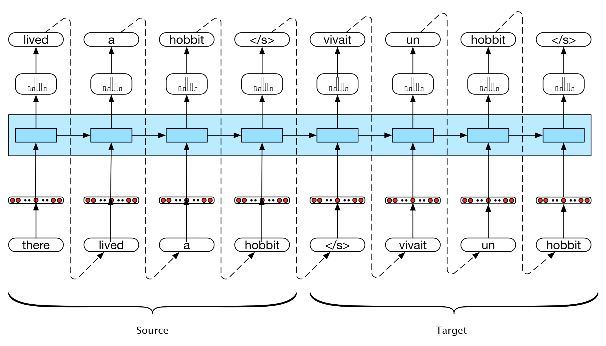
Extend to Neural Machine Translation (NMT)
Early efforts using this clever approach demonstrated good results on standard datasets.

Slide 11
Encoder-Decoder Networks

Slide 12
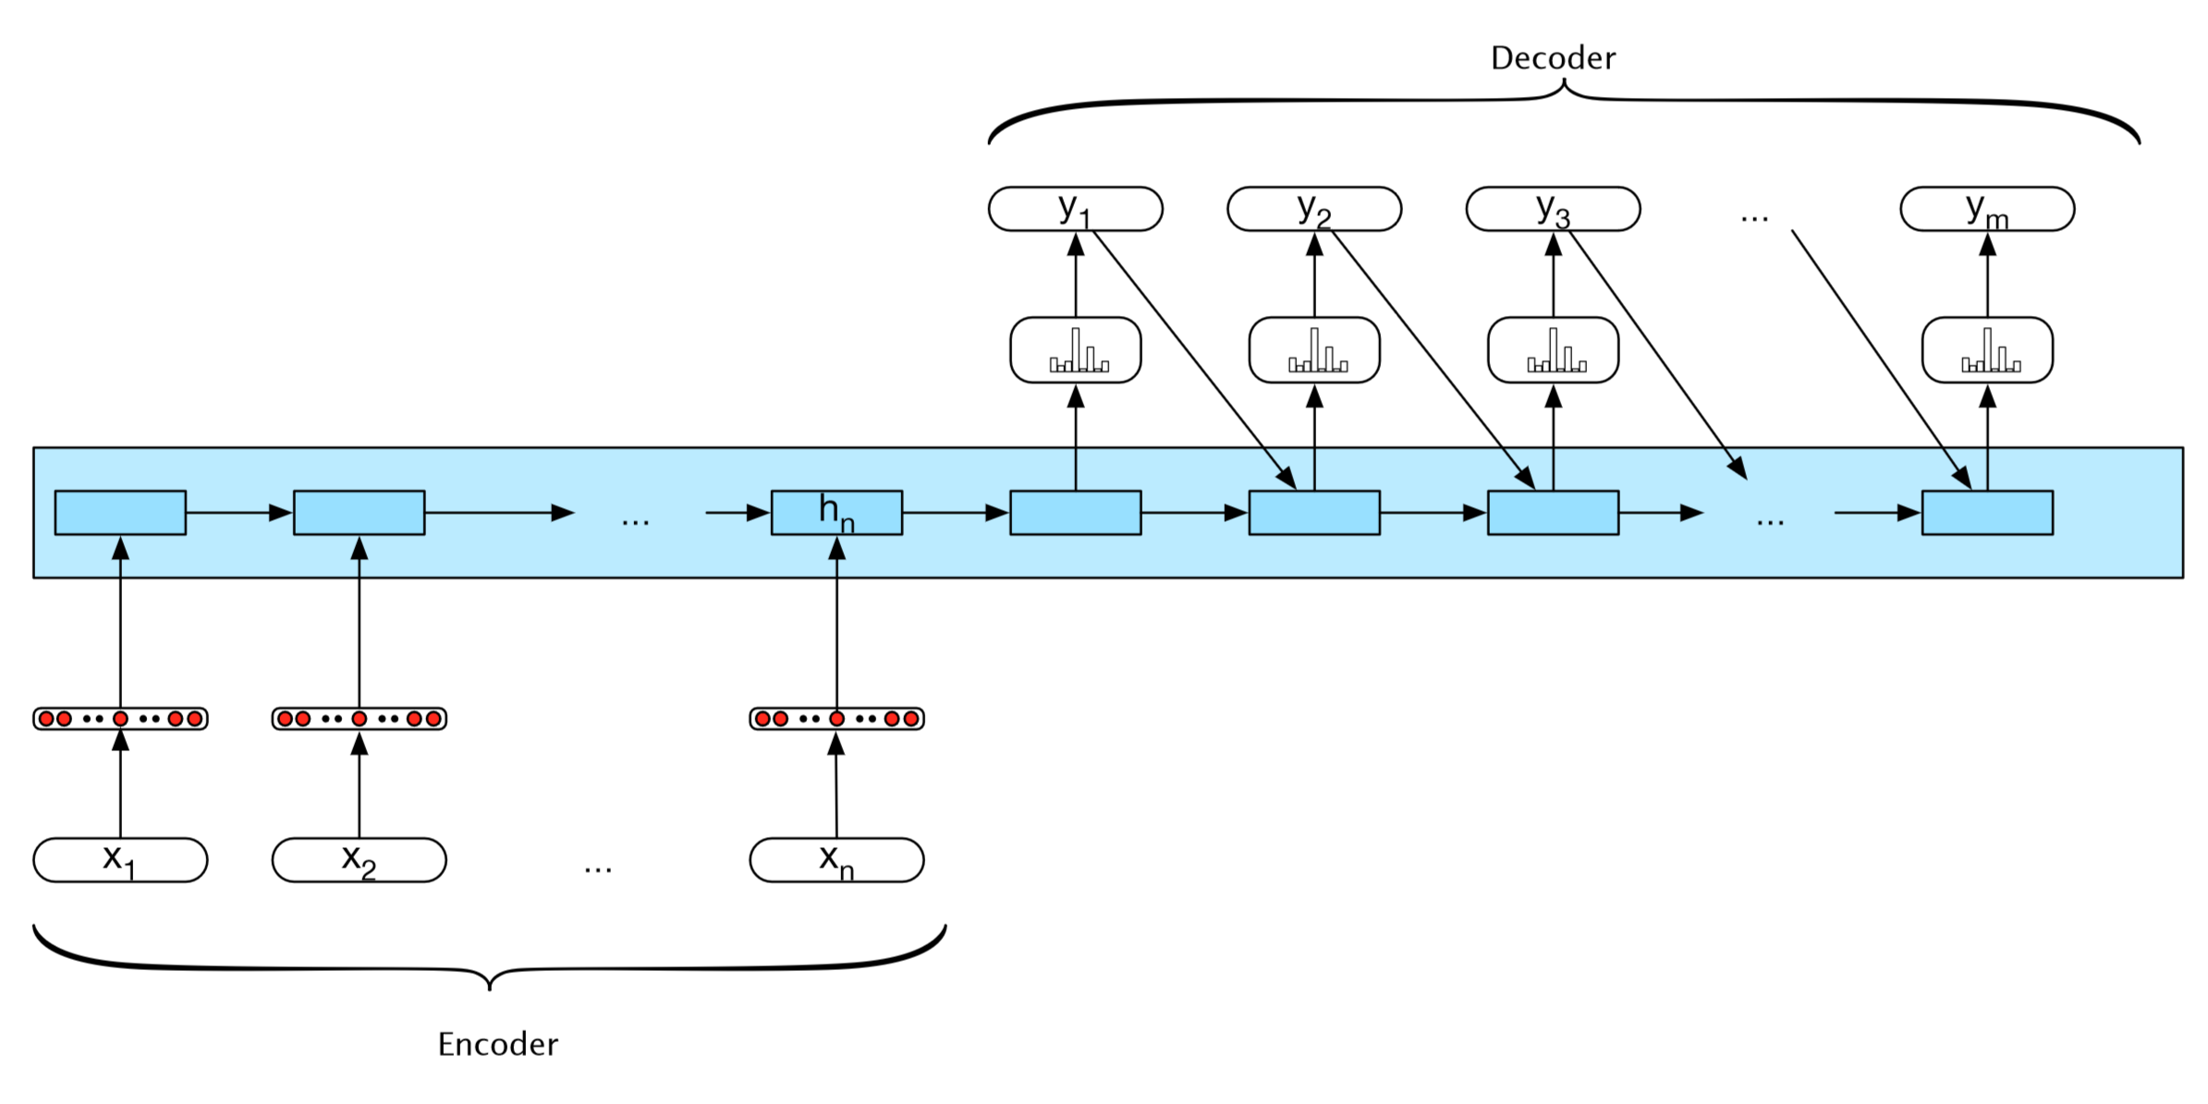
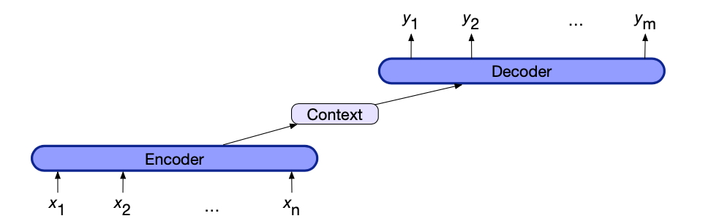
Basic RNN-based encoder-decoder architecture

Slide 13
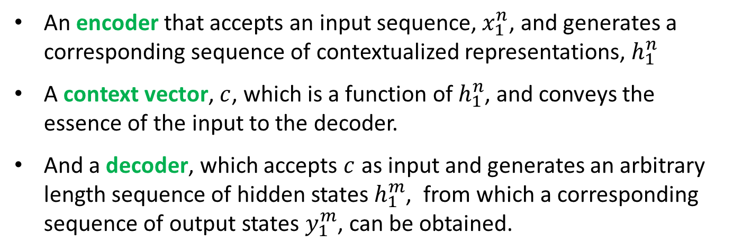
Encoder-Decoder architecture
Encoder-decoder networks consist of three components:
An encoder that accepts an input sequence, $x_{1}^{n}$, and generates a corresponding sequence of contextualized representations, $h_{1}^{n}$
A context vector, $c$, which is a function of $h_{1}^{n}$, and conveys the essence of the input to the decoder.
And a decoder, which accepts $c$ as input and generates an arbitrary length sequence of hidden states $h_{1}^{m}$, from which a corresponding sequence of output states $y_{1}^{m}$, can be obtained.

Slide 14
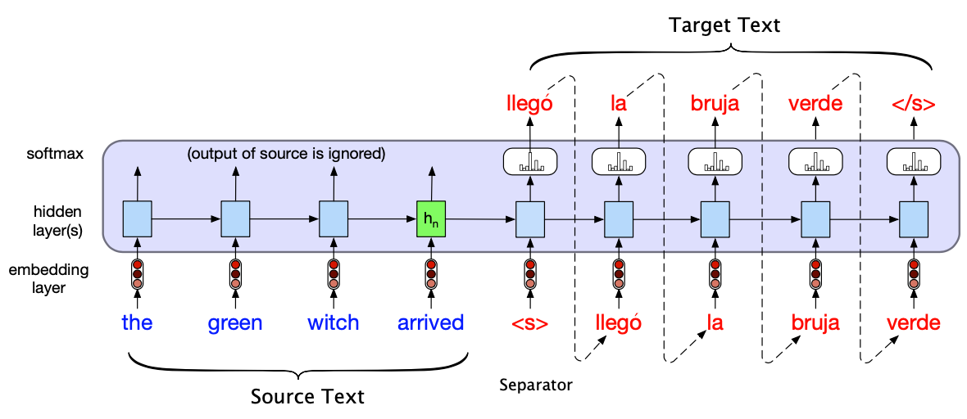
Encoder-Decoder architecture for Translation
Notes:
Translating a single sentence (inference time) in the basic RNN version of encoder-decoder approach to machine translation. Source and target sentences are concatenated with a separator token in between, and the decoder uses context information from the encoder’s last hidden state

Slide 15
Encoder
Possible implementation:
Simple RNNs, LSTMs, GRUs, convolutional networks, as well as transformer networks (discussed later in this chapter)
Other variation: stacked architectures
Stacked Bi-LSTMs is a widely used encoder design.

Slide 16
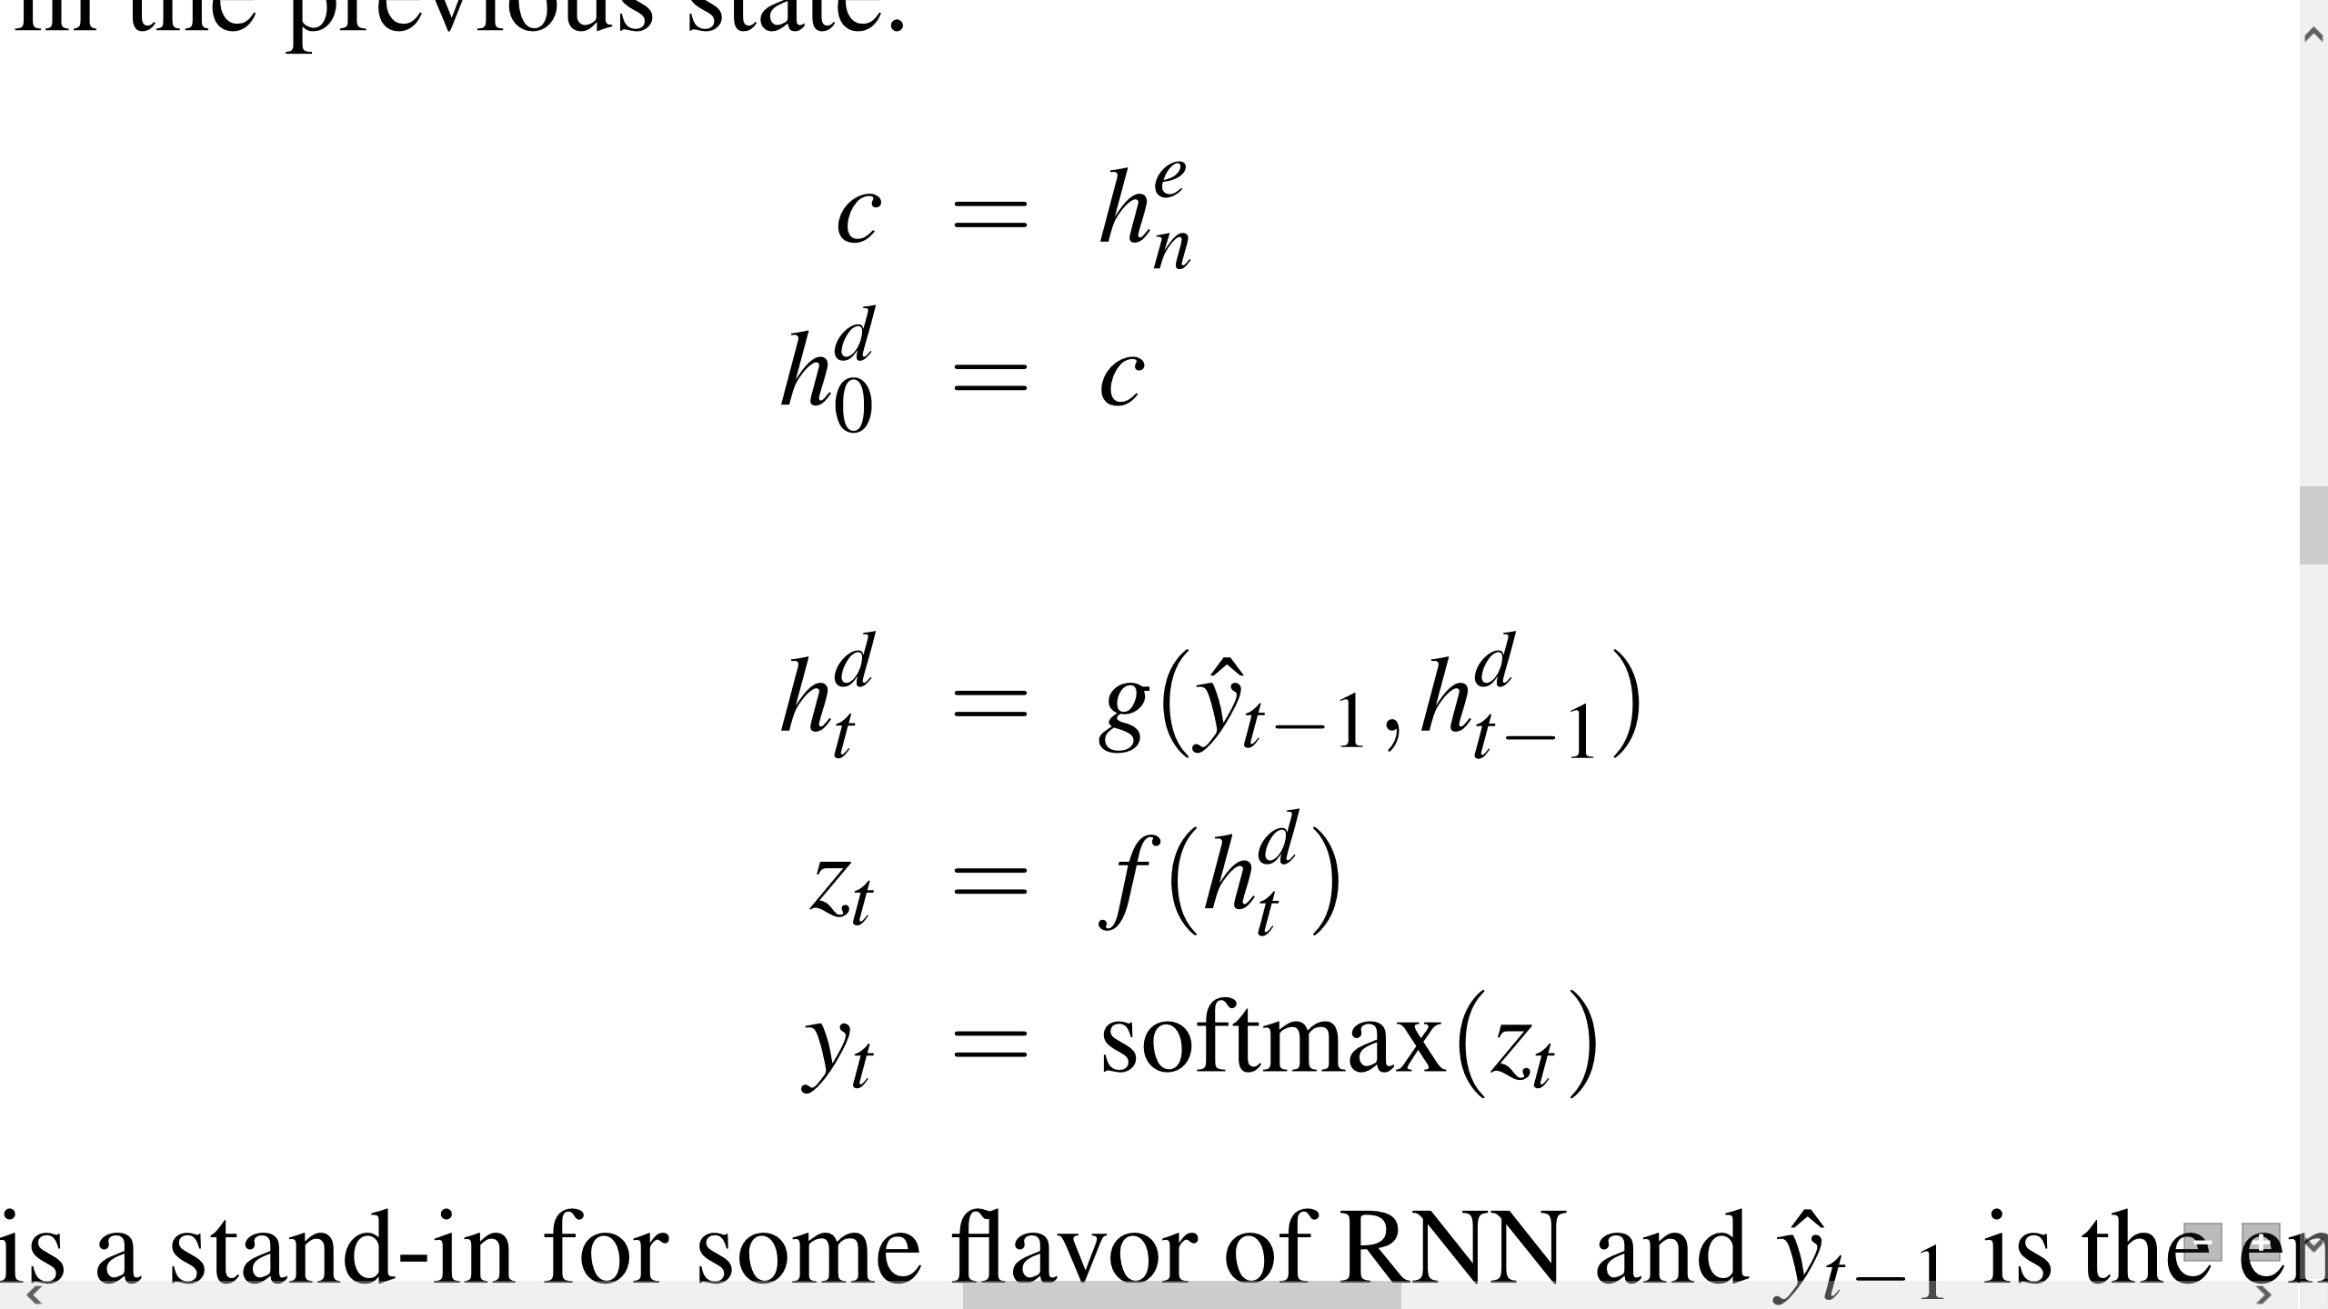
Decoder
Typical approach: LSTM or GRU-based RNN
The context vector, c, is only directly available at the beginning of the process and its inﬂuence will wane as the output sequence is generated.

Slide 17
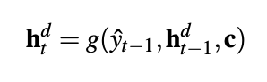
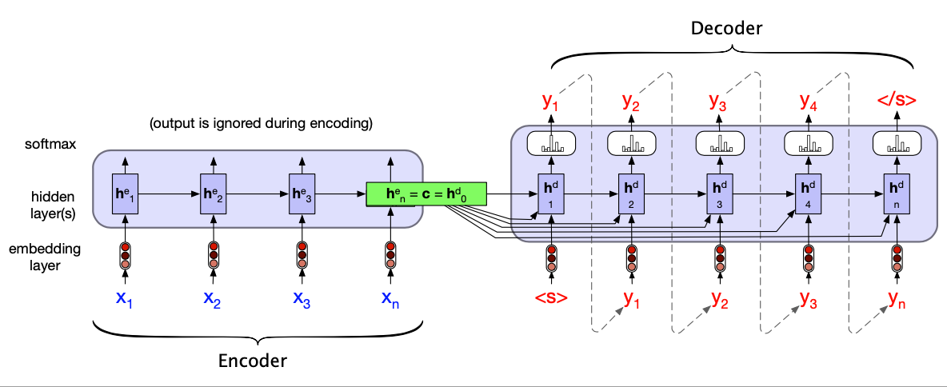
Variation to Allow Decoder States Influenced by Context
Notes:
A more formal version of translating a sentence at inference time in the basic RNN-based encoder-decoder architecture. The final hidden state of the encoder RNN serves as the context for the decoder in the decoder RNN.
接下来还是回到标准的decoder

Slide 18
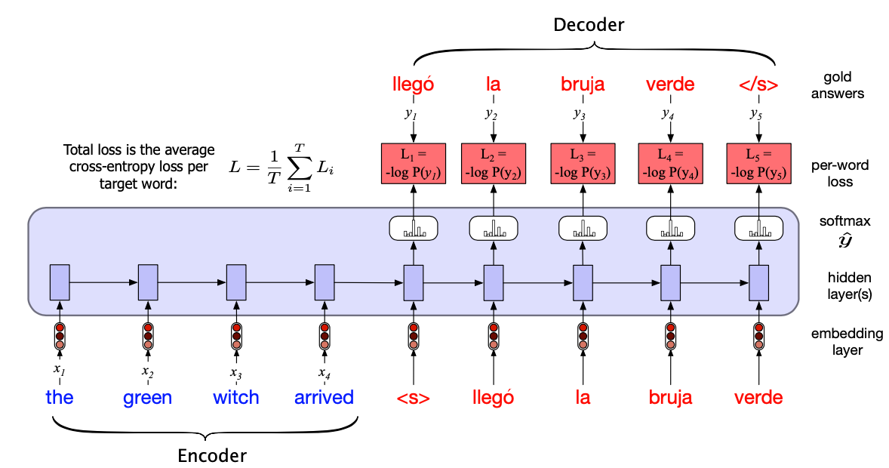
Training the basic RNN encoder-decoder
Notes:
Note that in the decoder we usually don’t propagate the model’s softmax outputs yˆt , but use teacher forcing to force each input to the correct gold value for training. We compute the softmax output distribution over yˆ in the decoder in order to compute the loss at each token, which can then be averaged to compute a loss for the sentence.

Slide 19
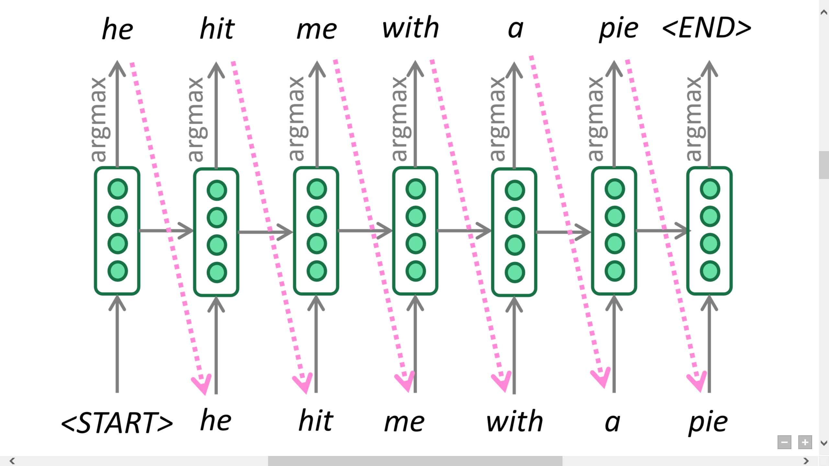
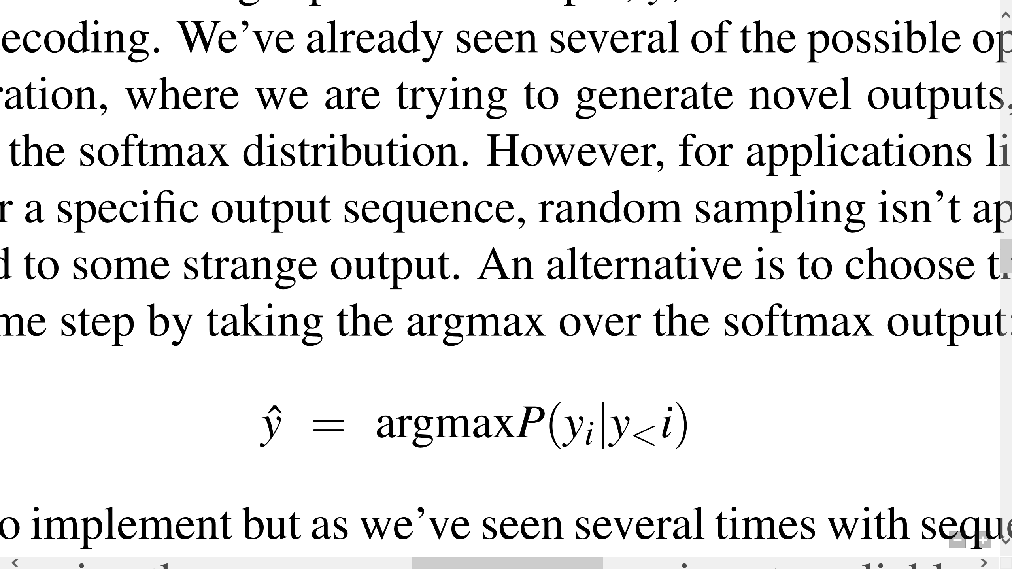
Greedy decoding
Greedy decoding: generate (or “decode”) the target sentence by taking argmax on each step of the decoder

Slide 20
Problem with greedy decoding
It doesn’t guarantee that the individual choices being made make sense together and combine into a coherent whole
It has no way to undo decisions!
Input: il a m’entarté (he hit me with a pie)
→ he ____
→ he hit ____
→ he hit a ____ (whoops! no going back now…)

Slide 21
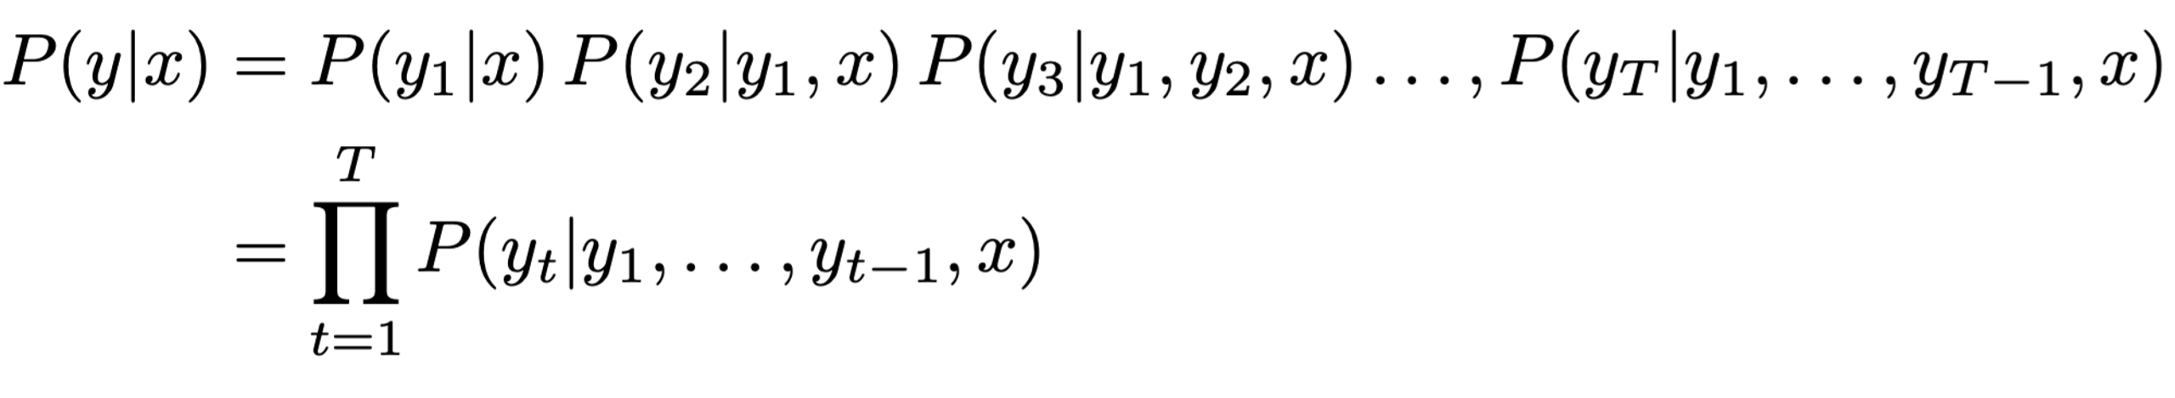
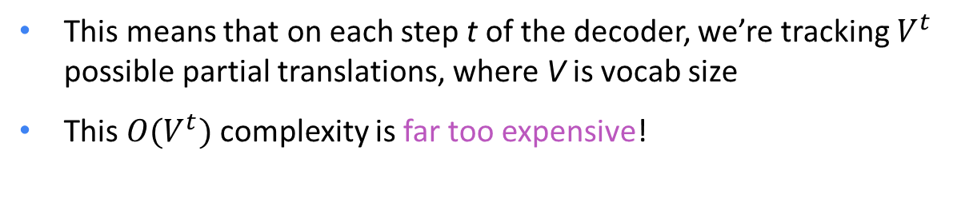
Exhaustive search decoding
Ideally we want to find a (length T) translation y that maximizes
We could try computing all possible sequences y
This means that on each step t of the decoder, we’re tracking $V^{t}$ possible partial translations, where V is vocab size
This ${O(V}^{t})$ complexity is far too expensive!

Slide 22
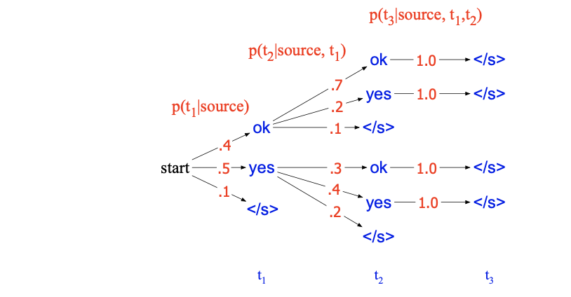
A Search Tree in Exhaustive Search Decoding

Slide 23
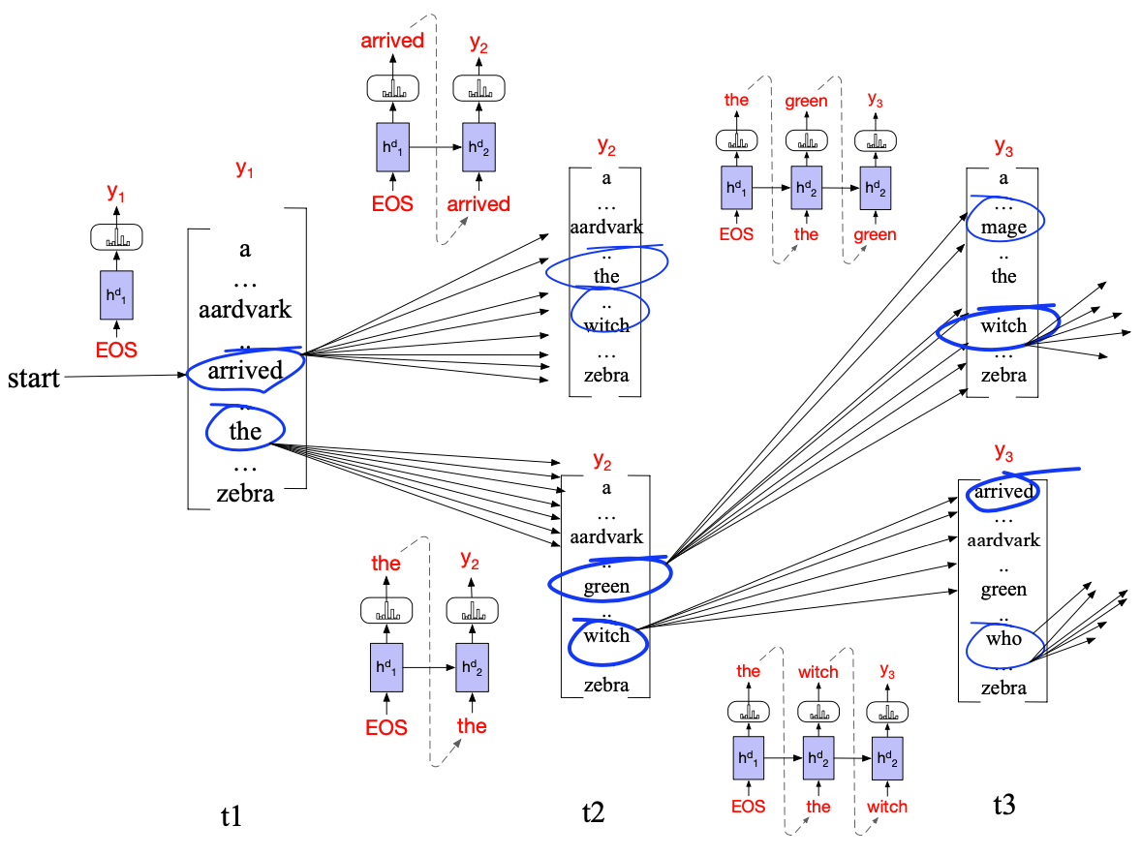
Beam search decoding
Notes:
Beam search decoding with a beam width of k = 2. At each time step, we choose the k best hypotheses, compute the V possible extensions of each hypothesis, score the resulting k ∗ V possible hypotheses and choose the best k to continue.

Slide 24
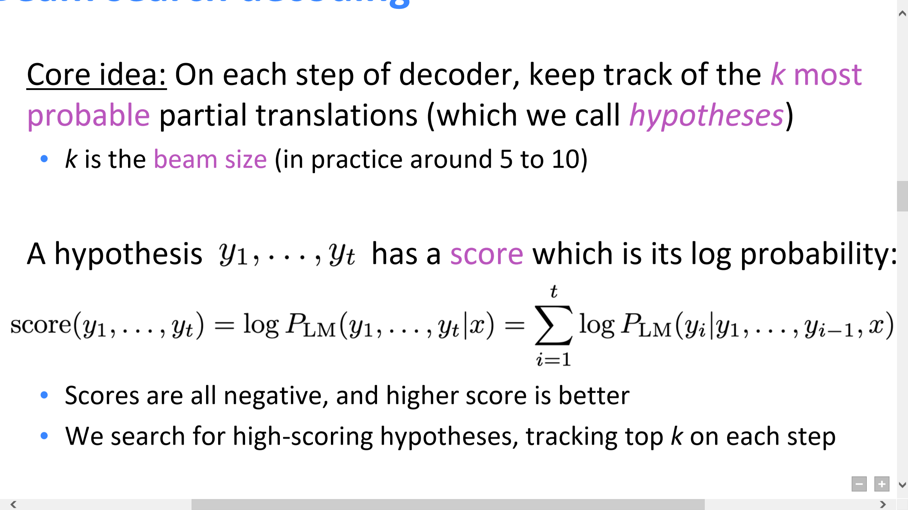
Beam search decoding
Core idea: On each step of decoder, keep track of the k most probable partial translations (which we call hypotheses)
k is the beam size (in practice around 5 to 10)
A hypothesis $y_{1}, …, y_{t}$ has a score which is its log probability:
Scores are all negative, and higher score is better
We search for high-scoring hypotheses, tracking top k on each step
Beam search is not guaranteed to find optimal solution
But much more efficient than exhaustive search!

Slide 25
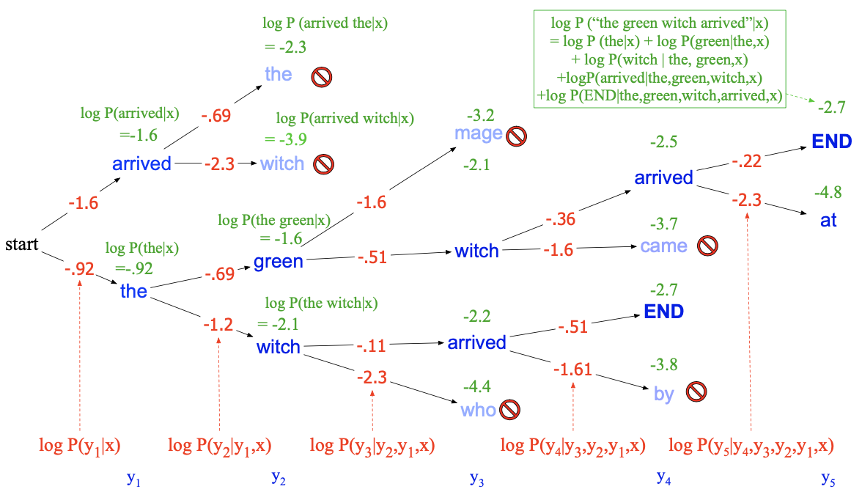
Beam search decoding

Slide 26
Attention

Slide 27
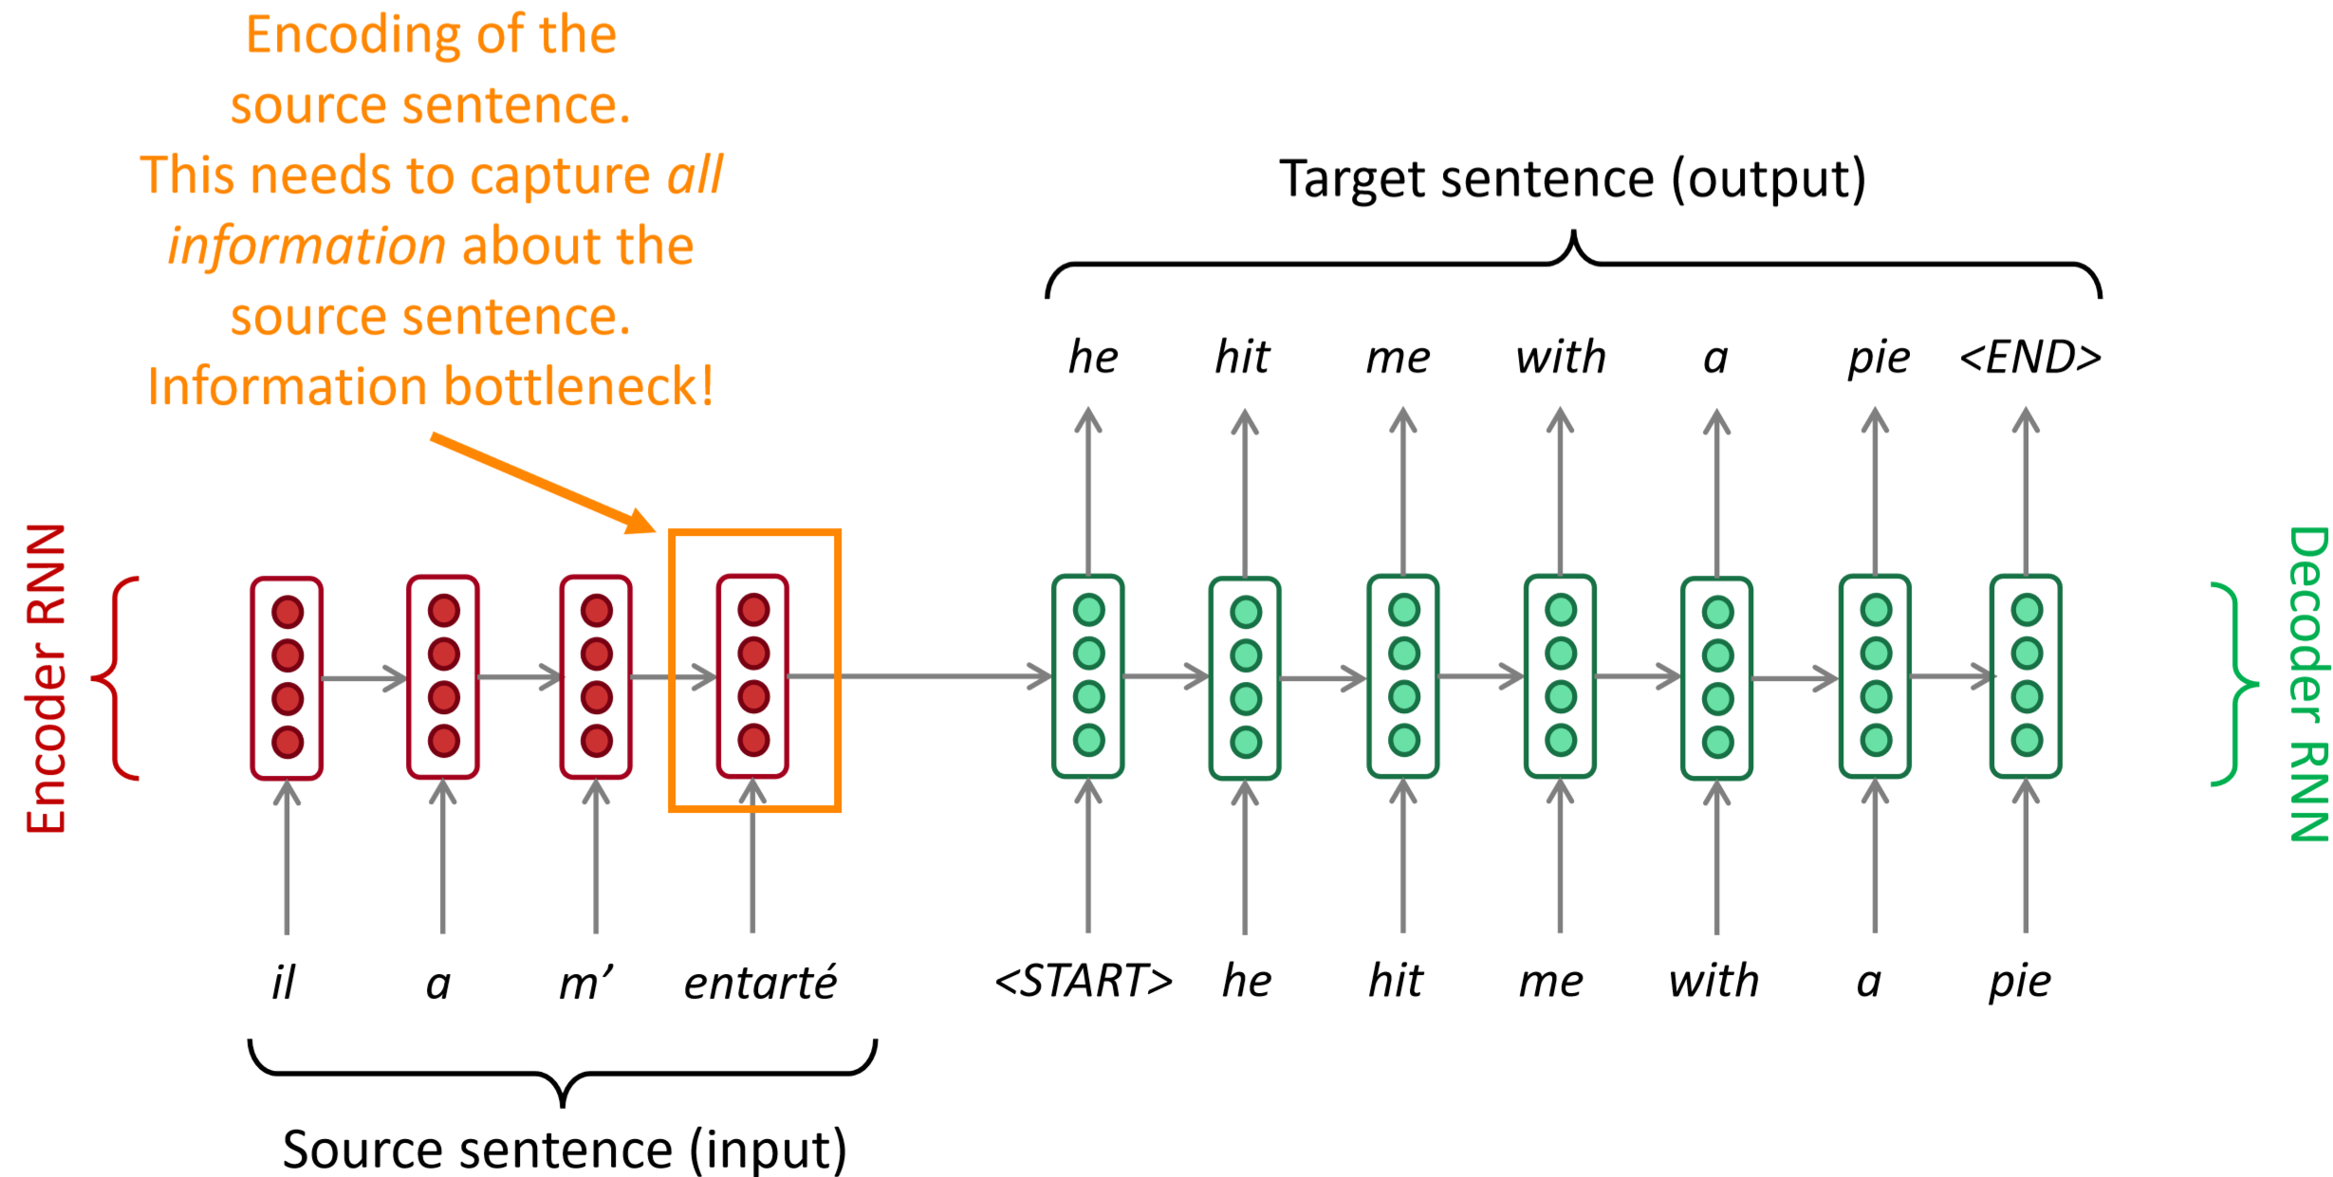
Sequence-to-sequence: the bottleneck problem

Slide 28

Attention
Focus on the relevant information while ignoring irrelevant information
An efficient mechanism that helps us process information

Slide 29
Attention
Attention mechanism: a solution to the bottleneck problem
take the entire encoder context into account, that dynamically updates during the course of decoding, and that can be embodied in a ﬁxed-size vector.

Slide 30
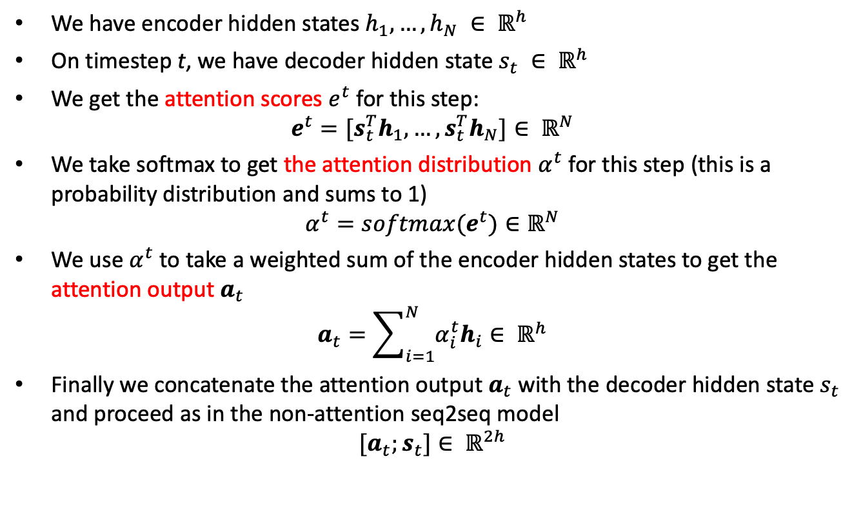
Attention
We have encoder hidden states $h_{1}, …, h_{N} ∈ ℝ^{h}$
On timestep t, we have decoder hidden state $s_{t} ∈ ℝ^{h}$
We get the attention scores $e^{t}$ for this step:
$$e^{t}=[s_{t}^{T}h_{1}, …, s_{t}^{T}h_{N}]∈ ℝ^{N}$$
We take softmax to get the attention distribution $α^{t}$ for this step (this is a probability distribution and sums to 1)
$$α^{t}=softmax(e^{t})∈ℝ^{N}$$
We use $α^{t}$ to take a weighted sum of the encoder hidden states to get the attention output $a_{t}$
$$a_{t}=\sum_{i=1}^{N}{α_{i}^{t}h_{i}}∈ ℝ^{h}$$
Finally we concatenate the attention output $a_{t}$ with the decoder hidden state $s_{t}$ and proceed as in the non-attention seq2seq model
$$[a_{t};s_{t}]∈ ℝ^{2h}$$

Slide 31
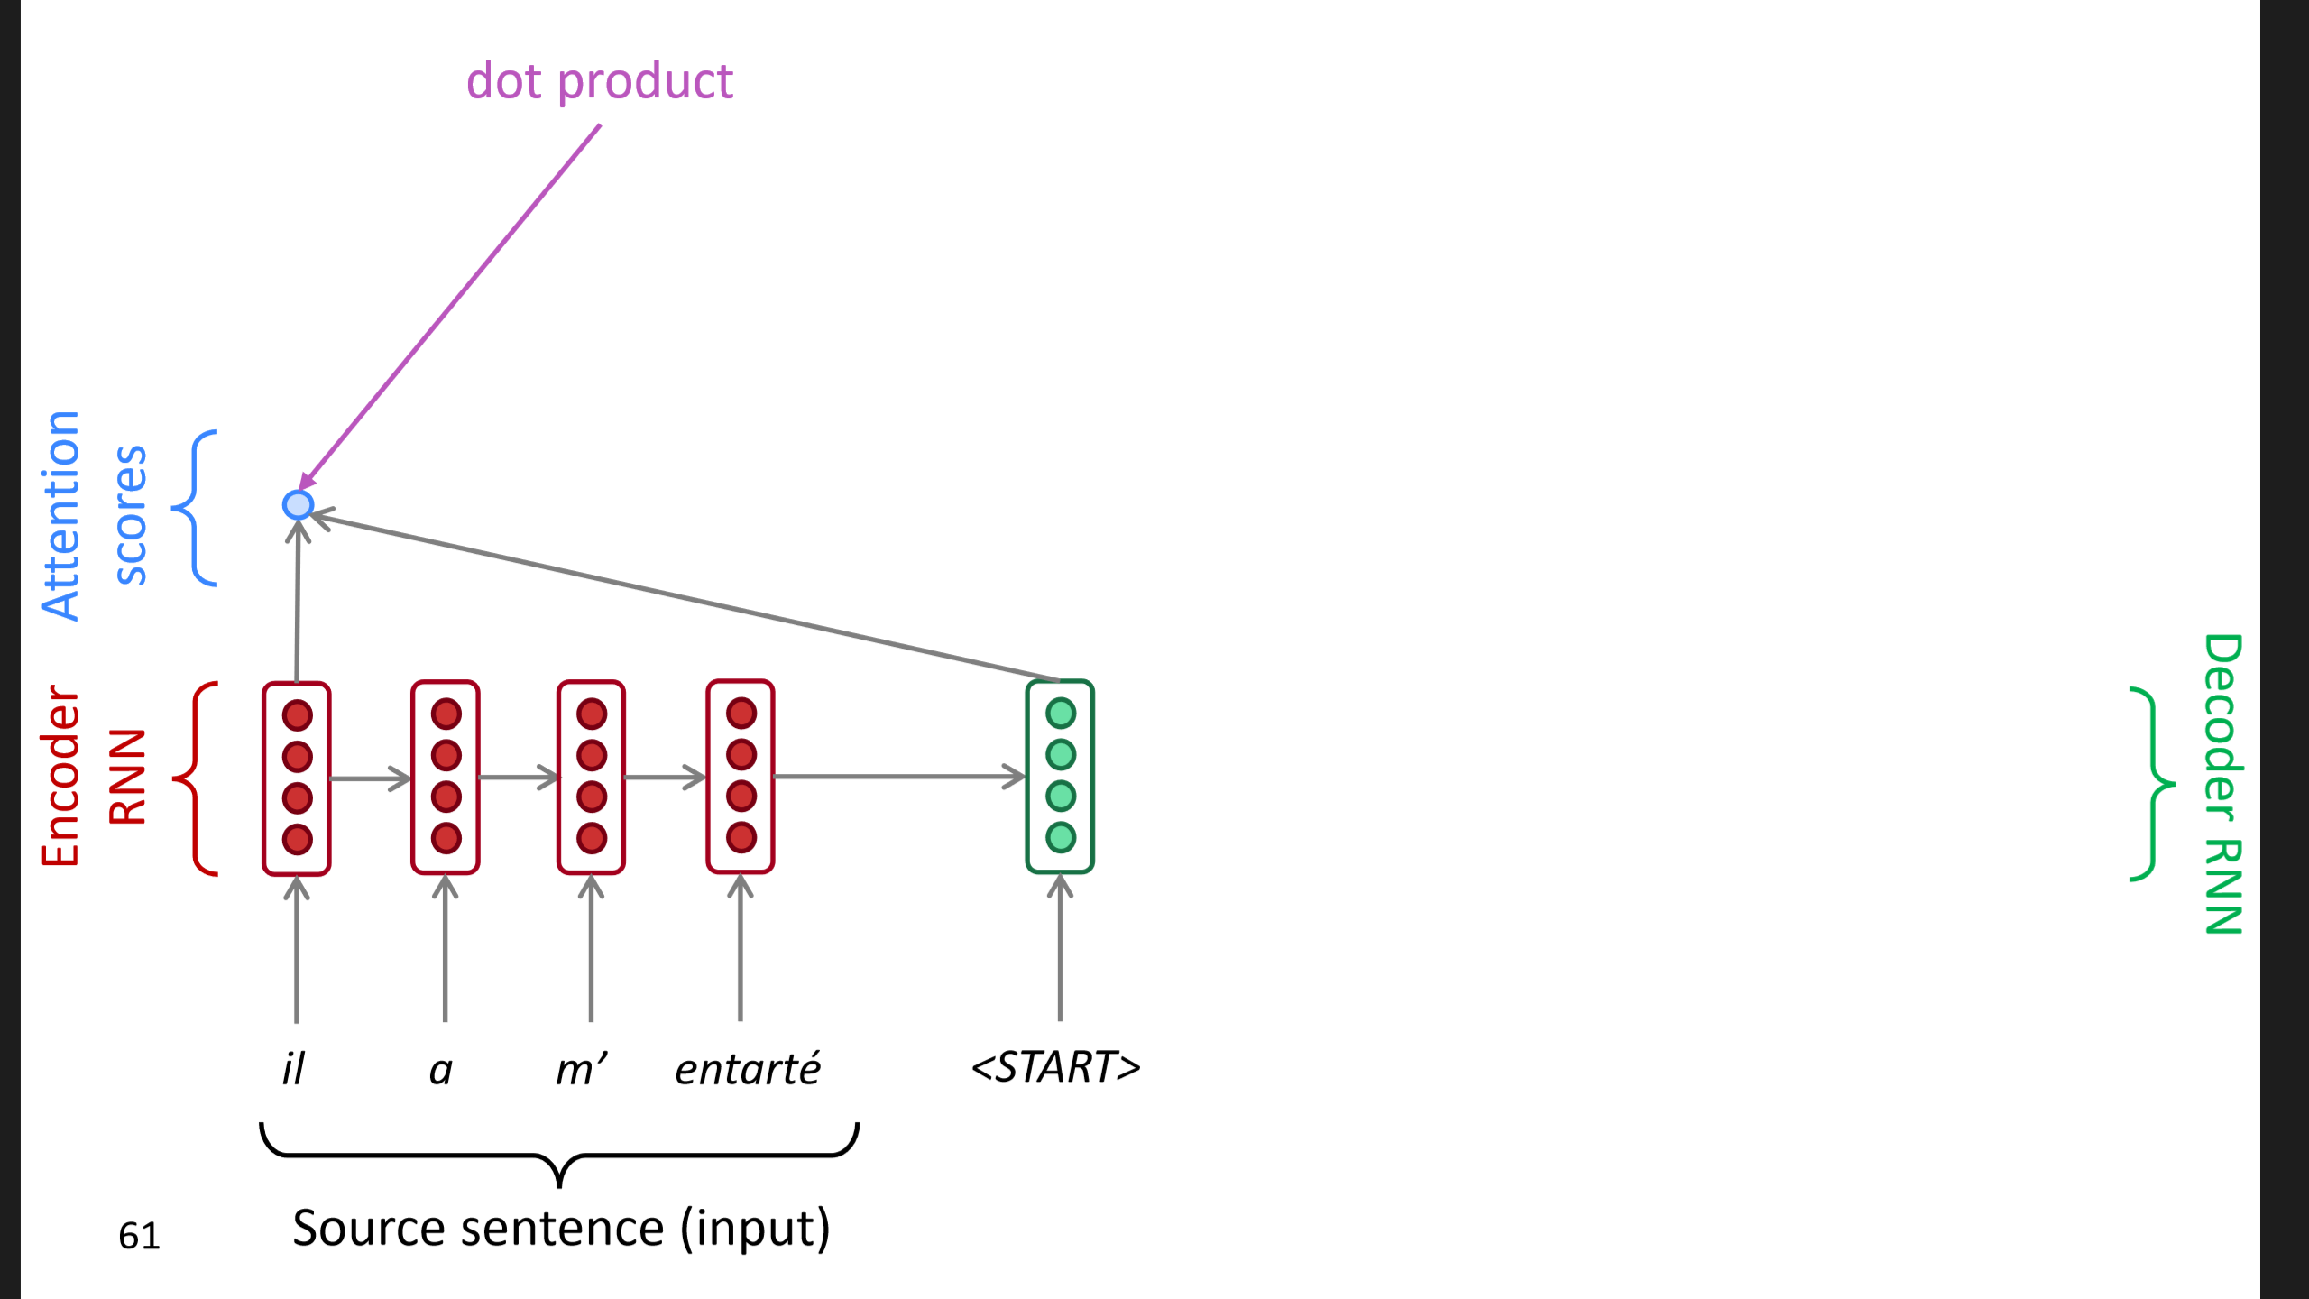
Sequence-to-sequence with attention

Slide 32
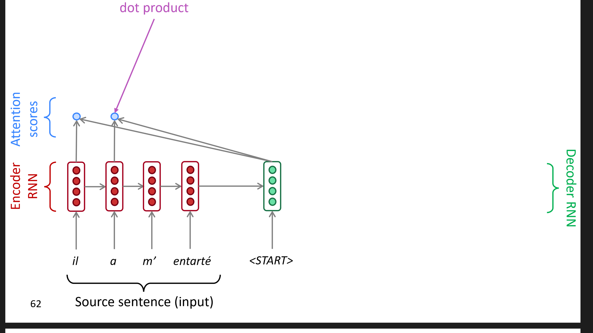
Sequence-to-sequence with attention

Slide 33
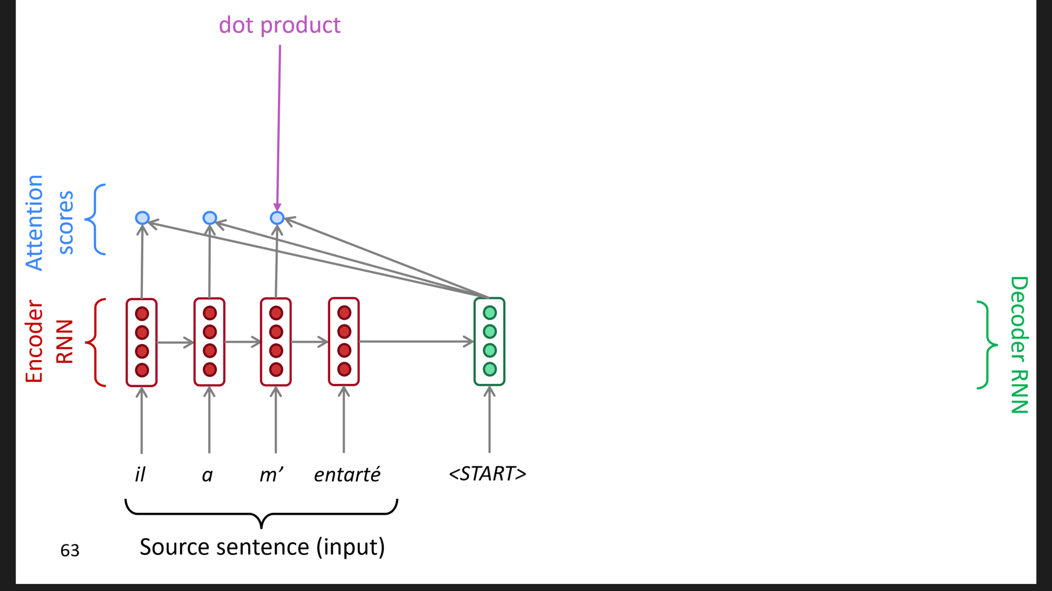
Sequence-to-sequence with attention

Slide 34
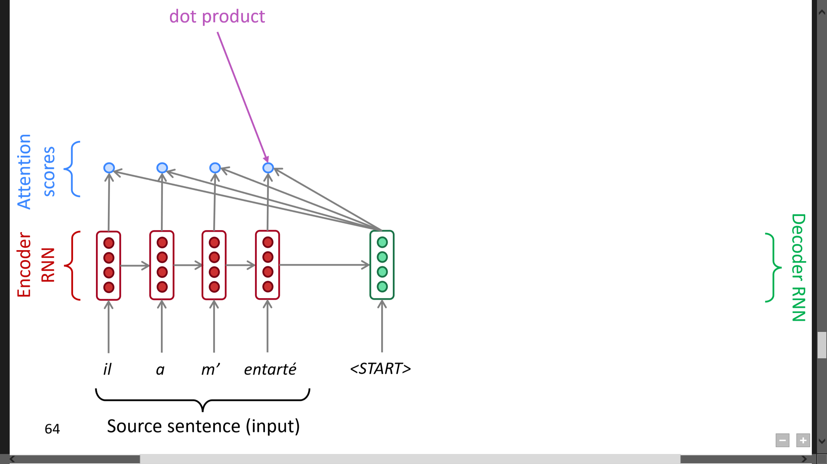
Sequence-to-sequence with attention

Slide 35
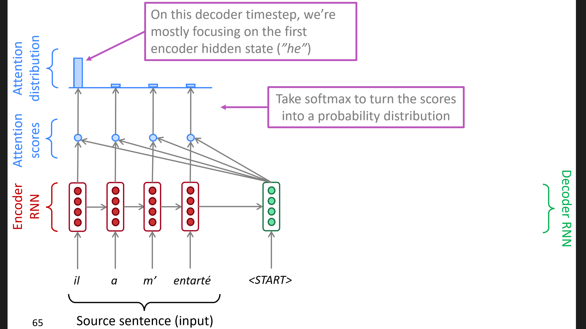
Sequence-to-sequence with attention

Slide 36
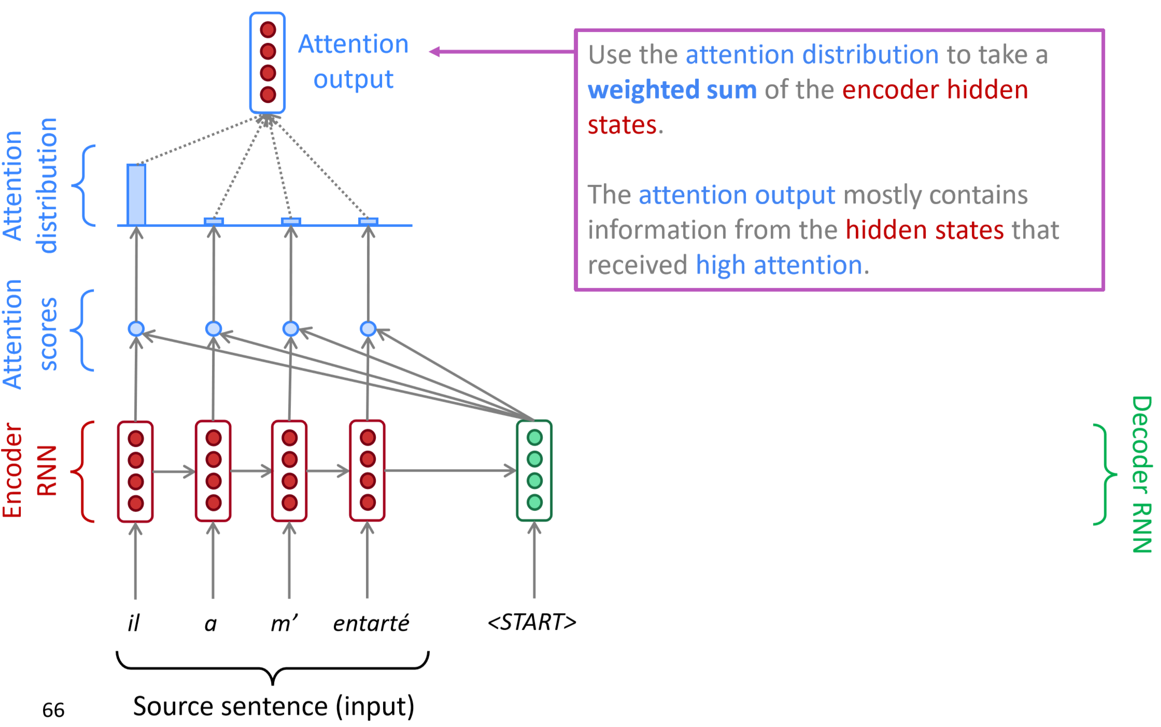
Sequence-to-sequence with attention

Slide 37
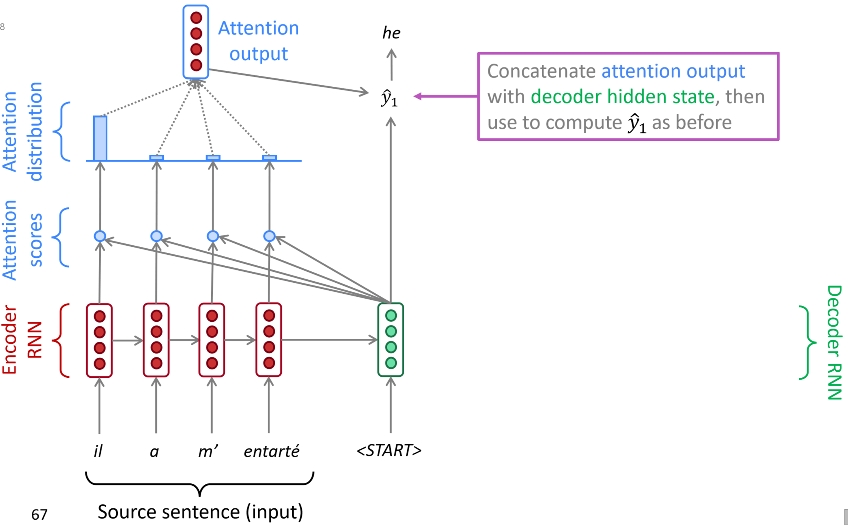
Sequence-to-sequence with attention

Slide 38
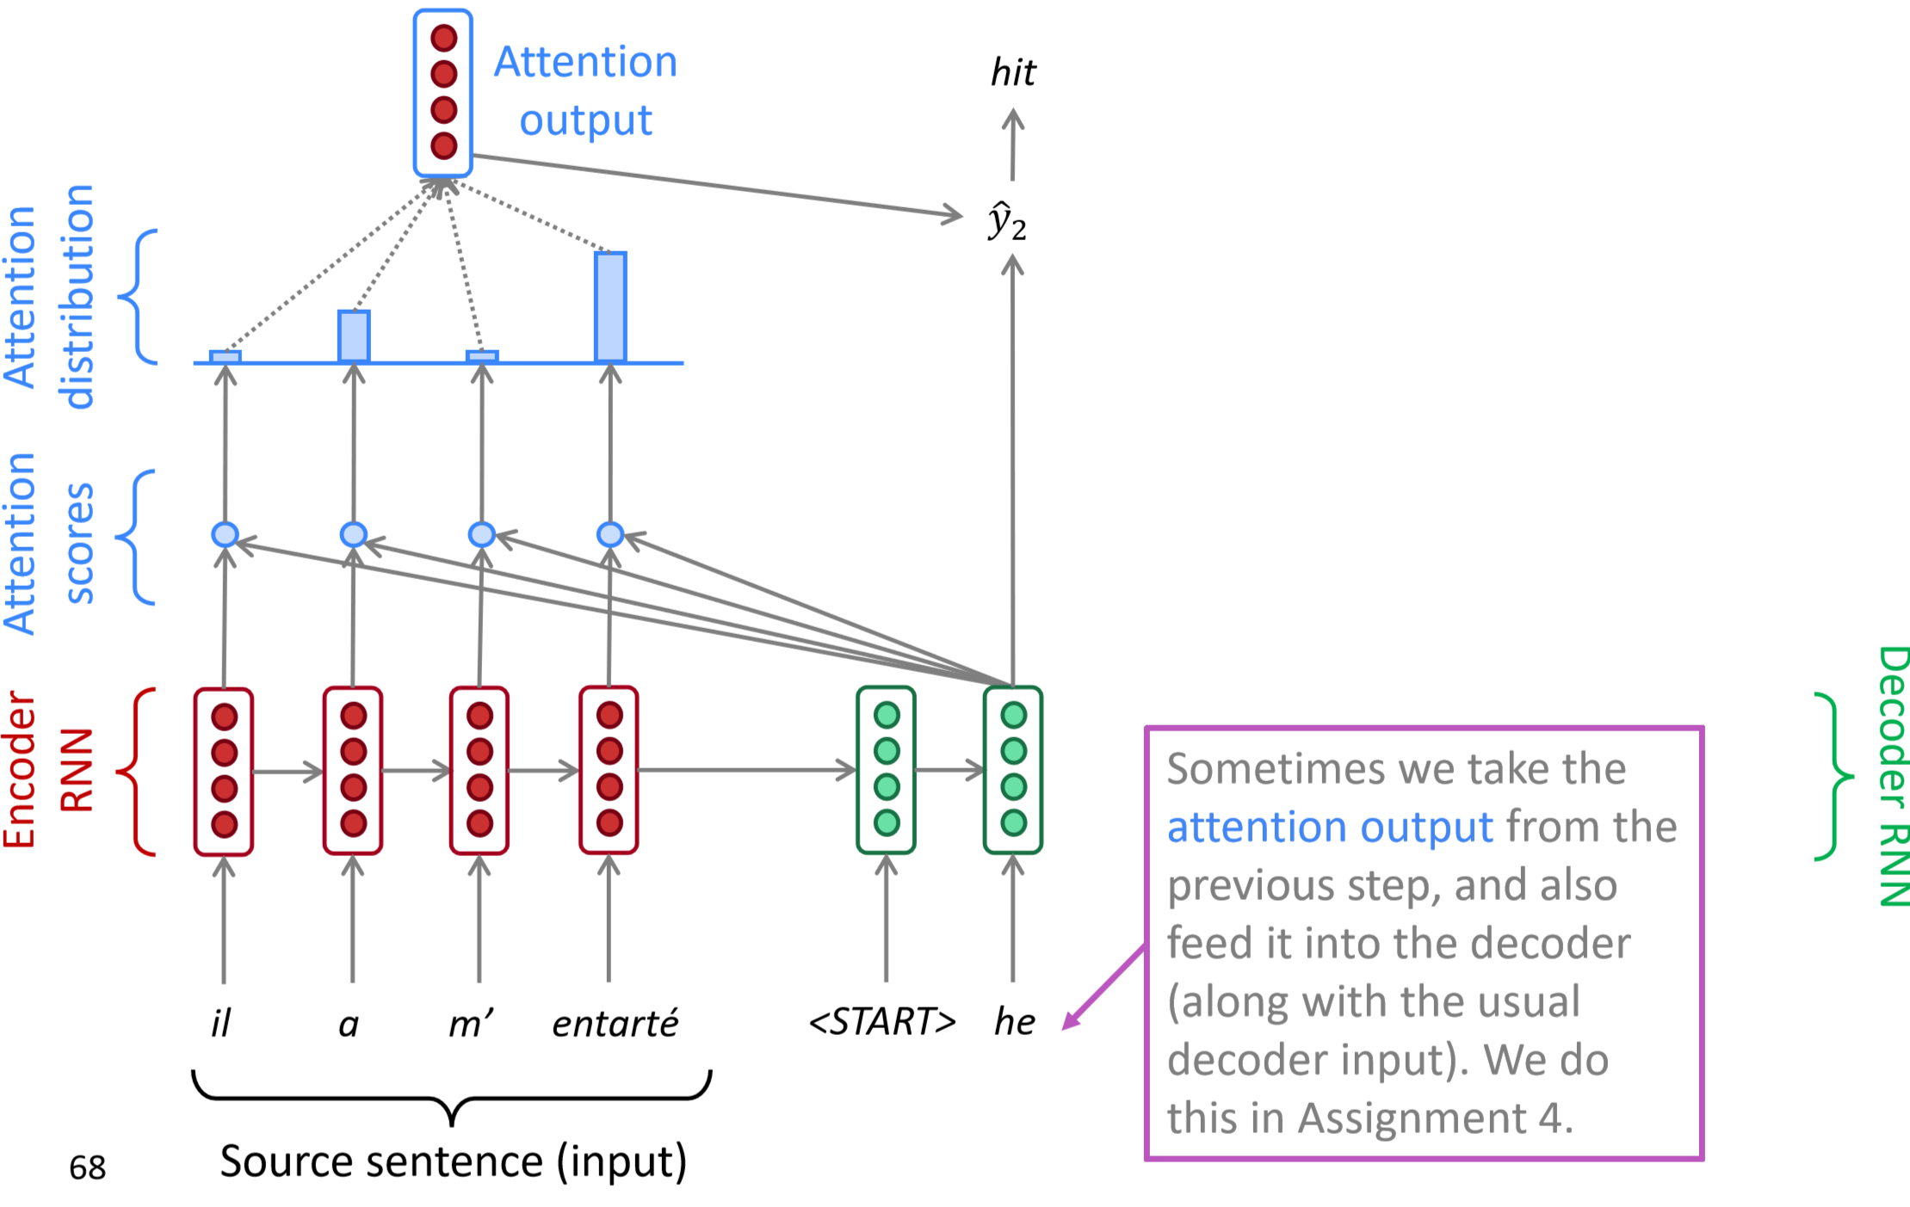
Sequence-to-sequence with attention

Slide 39
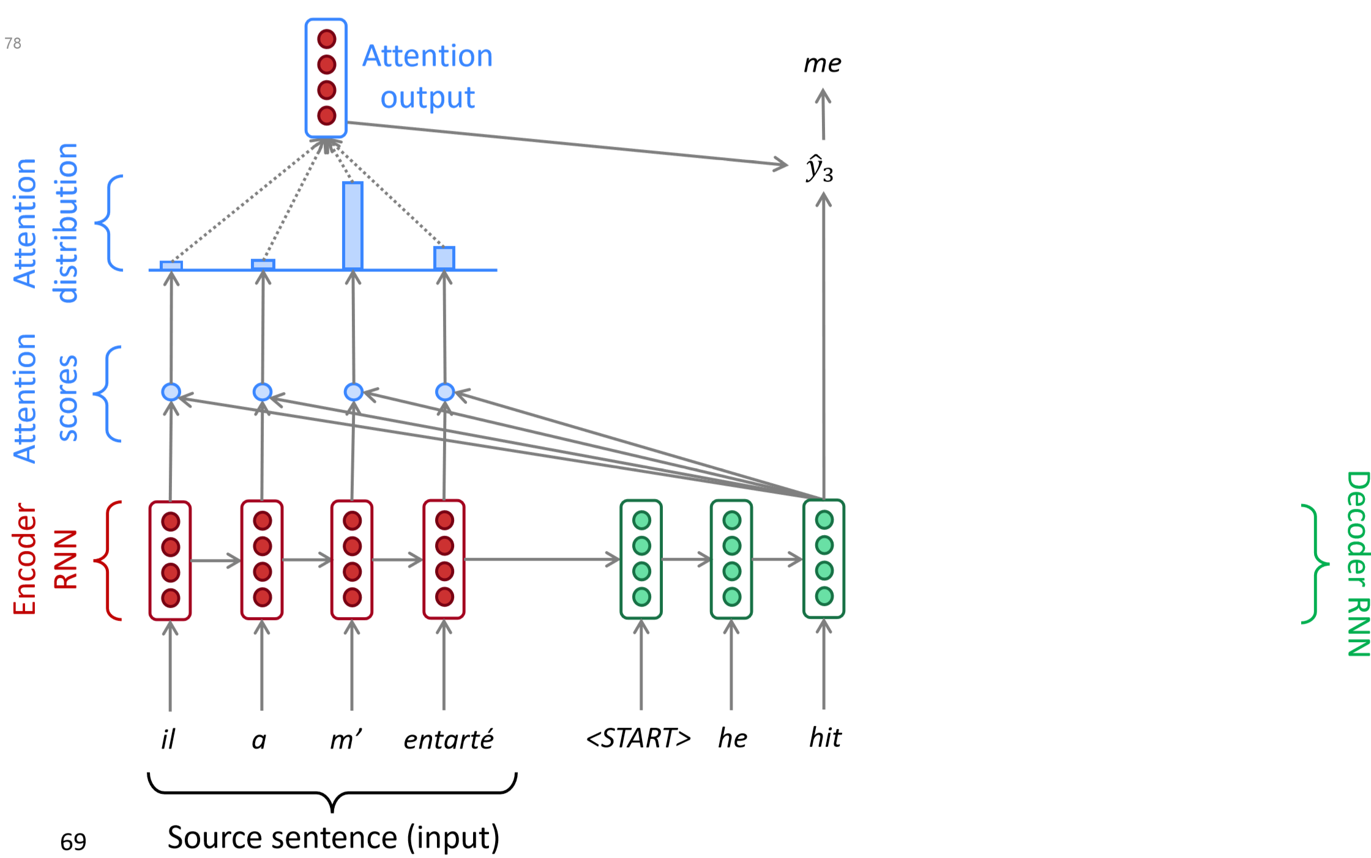
Sequence-to-sequence with attention

Slide 40
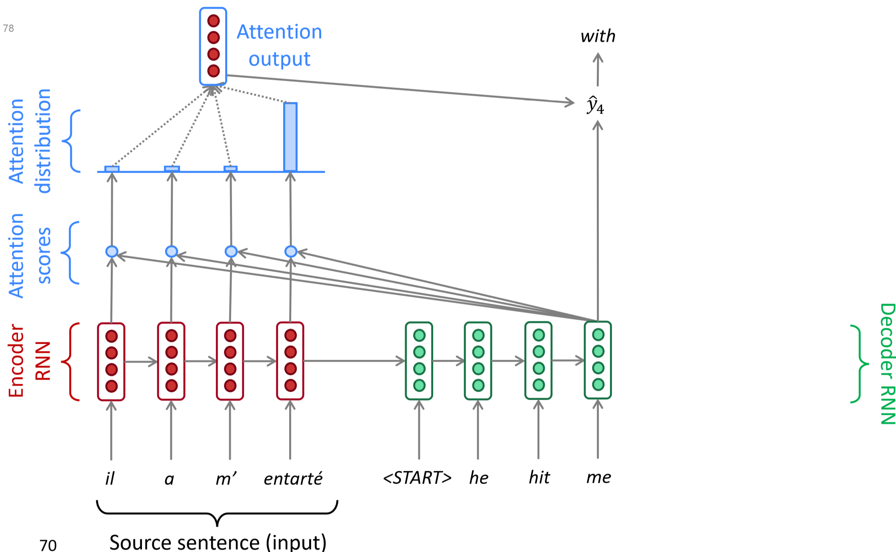
Sequence-to-sequence with attention

Slide 41
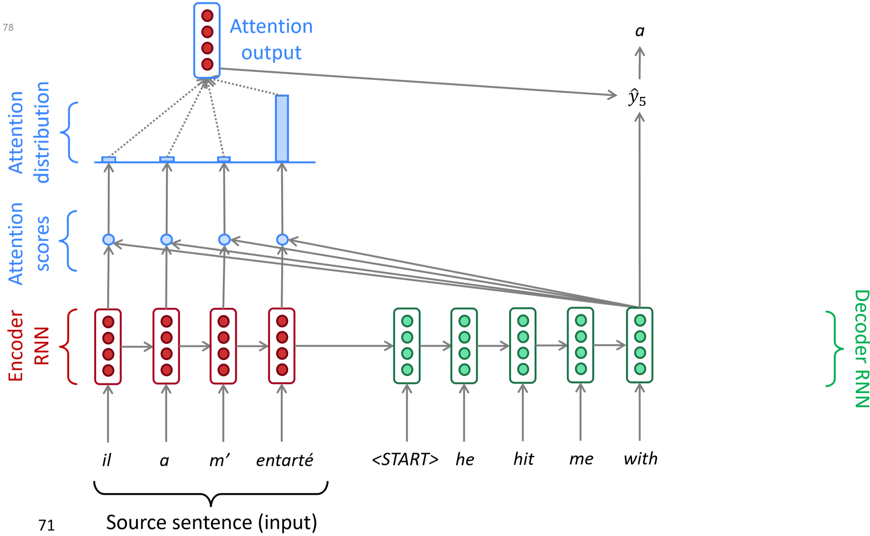
Sequence-to-sequence with attention

Slide 42
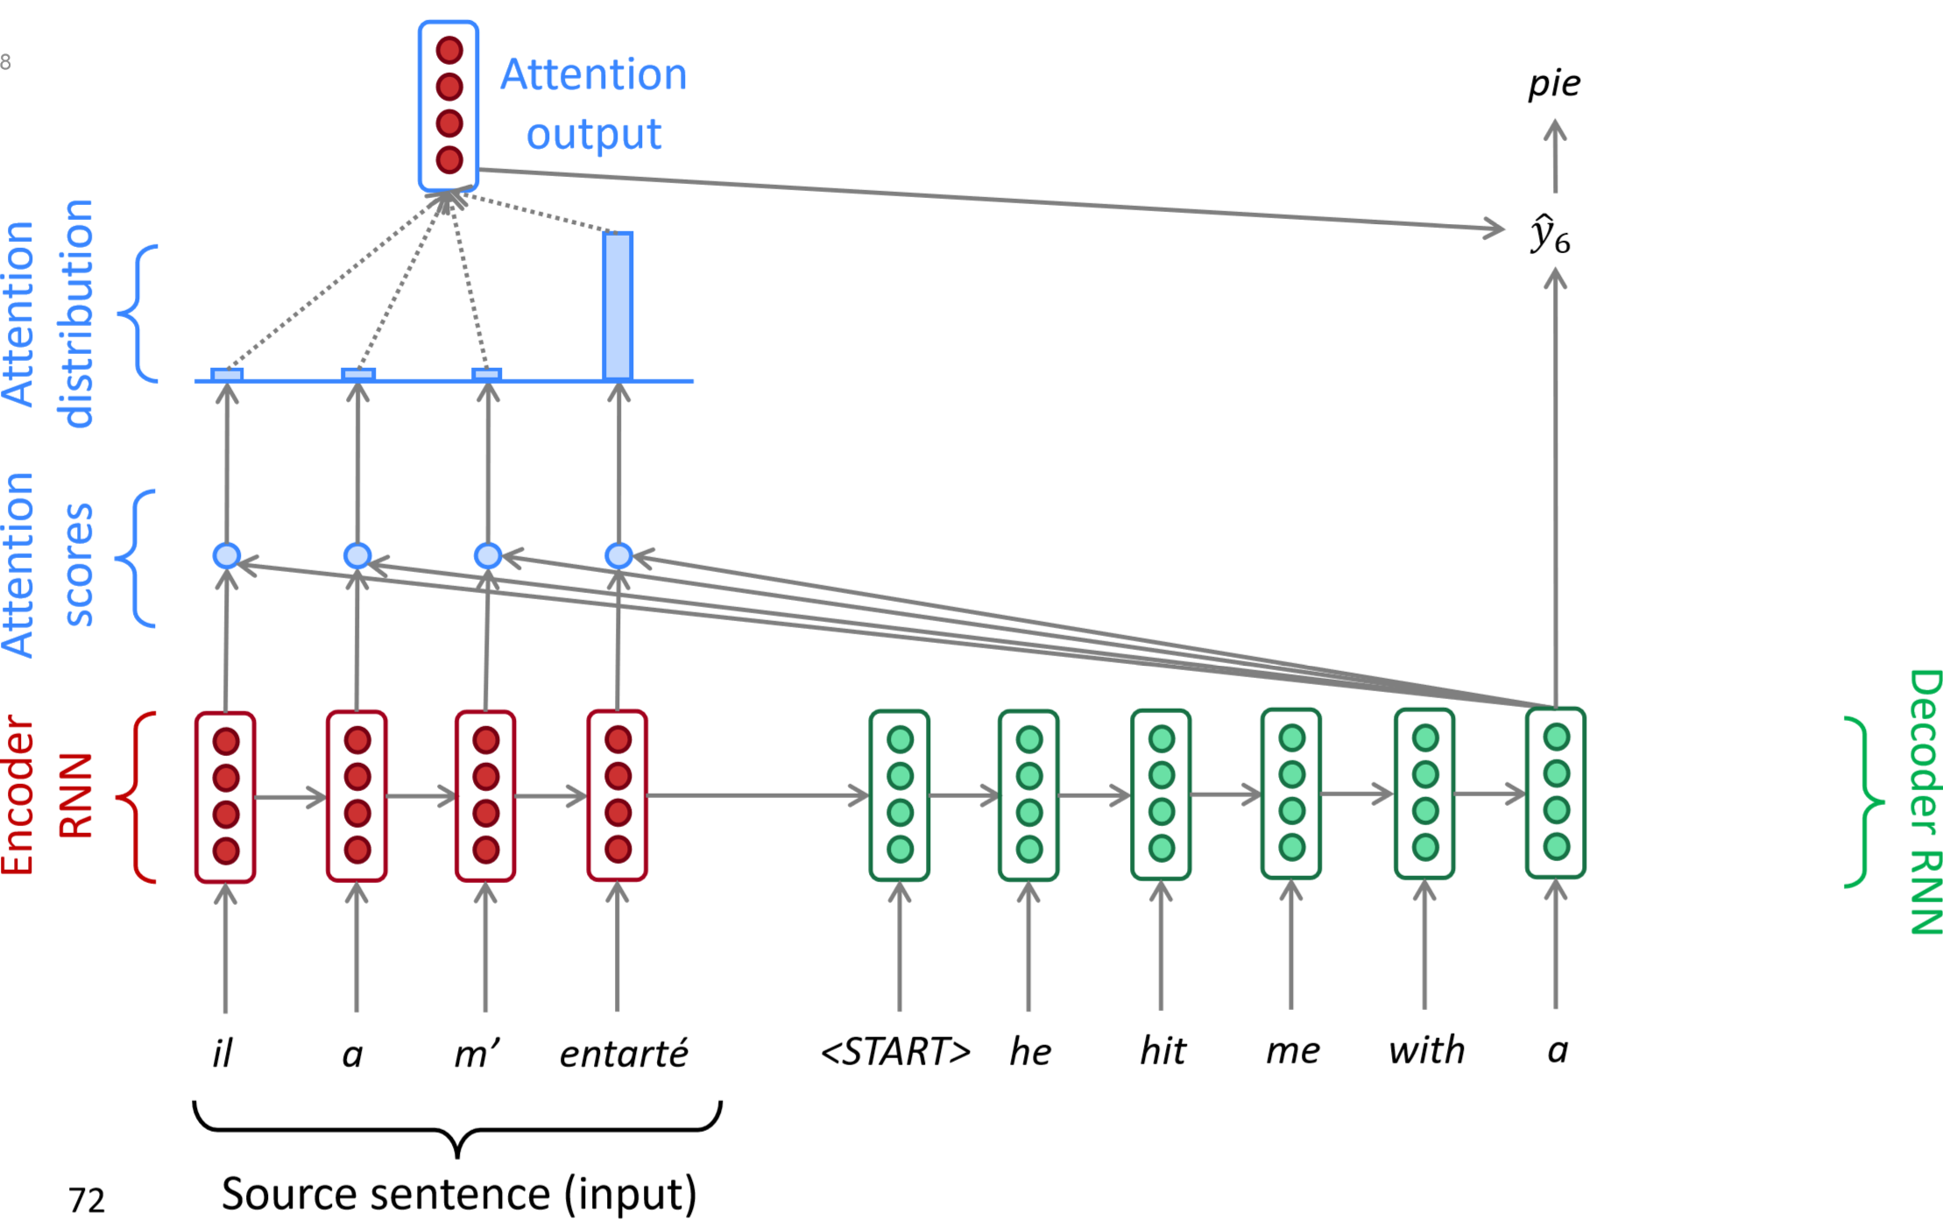
Sequence-to-sequence with attention

Slide 43
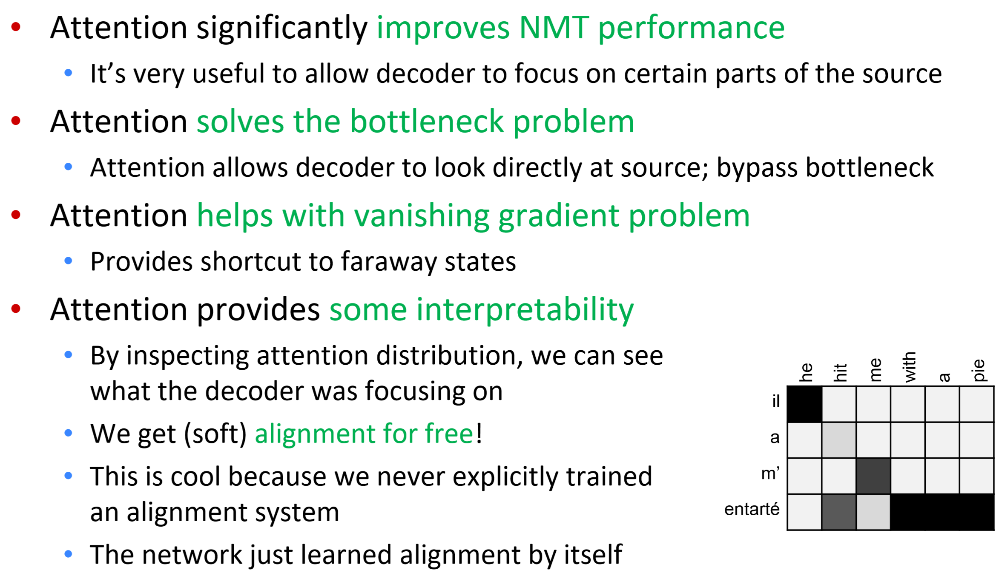
Attention is great

Slide 44
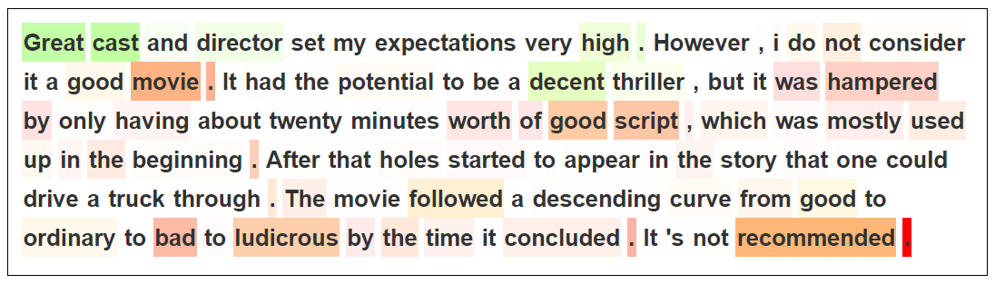
Attention visualization
Train an attentional model to classify movie reviews as positive or negative, and visualize the attention weights on each word:
Try it yourself: https://ulmfit.purecode.pl/

Slide 45
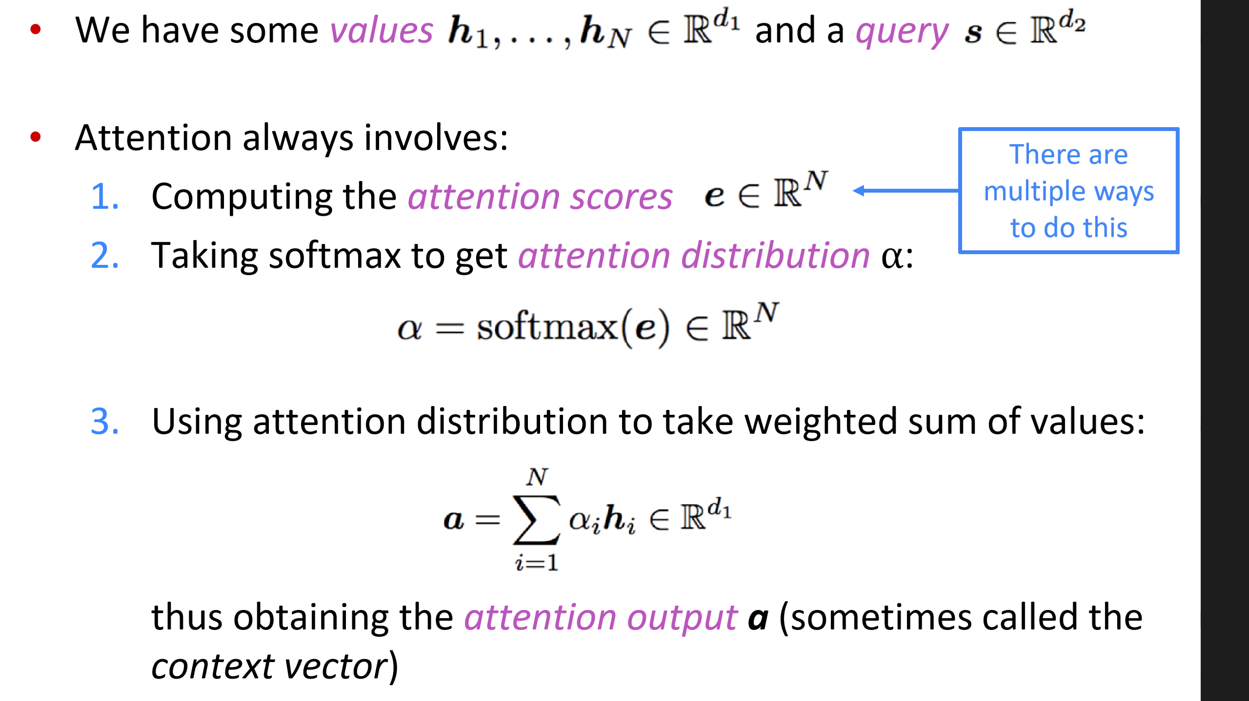
There are several attention variants

Slide 46
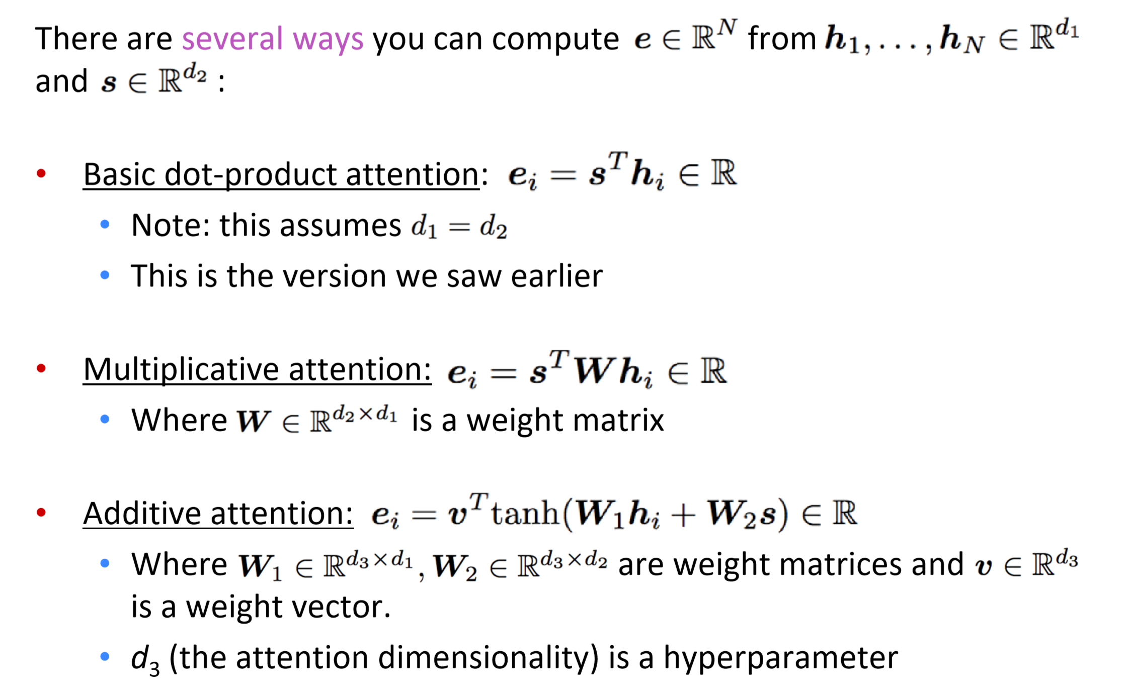
Attention variants

Slide 47
Applications of Encoder-Decoder Networks
The addition of attention to basic encoder-decoder networks led to rapid improvement in performance across a wide-range of applications including summarization, sentence simpliﬁcation, question answering and image captioning.

Slide 48
Attention is All You Need?
Defects of recurrent networks:
Gradient vanishing: Leads to a loss of information when sequence is long and difficulties in training
Sequential nature: Inhibits the use of parallel computational resources (e.g. GPUs)
Attention is great, can we build a network only with attention?

Slide 49
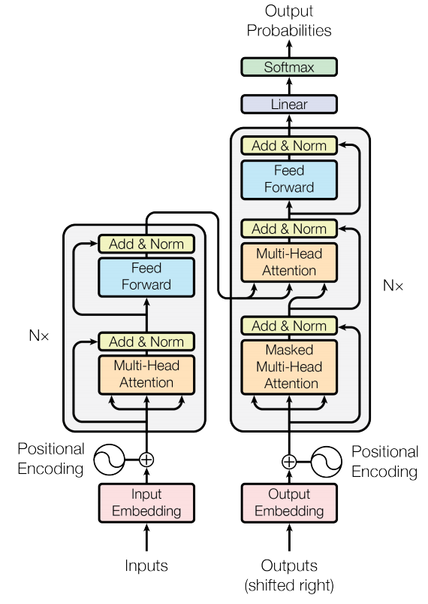
Transformer
Non-recurrent sequence-to-sequence encoder-decoder model
Task: machine translation with parallel corpus
Predict each translated word
Final cost/error function is standard cross-entropy error
Attention is all you need. 2017. Vaswani, Shazeer, Parmar, Uszkoreit, Jones, Gomez, Kaiser, Polosukhin
Notes:
首先开始介绍核心内容，自注意力层。

Slide 50
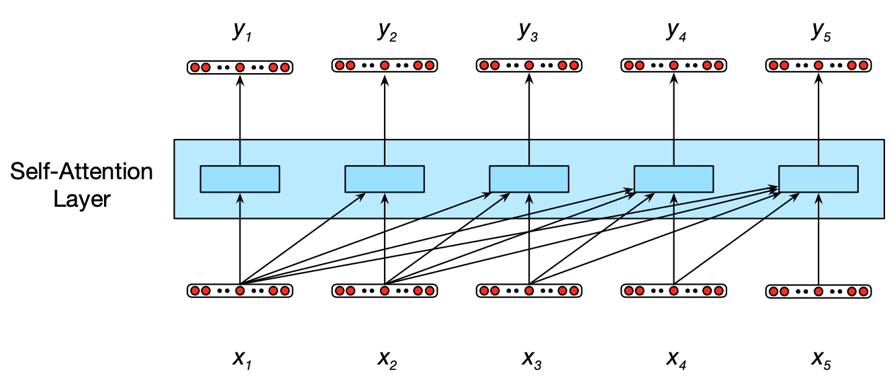
Information flow in a causal (or masked) self-attention model
Notes:
将输入xi映射到yi。
这是mask模型，所以y1只能看到x1. y2只能看到x1和x2.
所有yi的计算是独立的，所以可以并行计算。

Slide 51
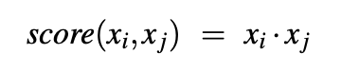
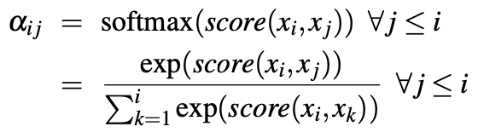
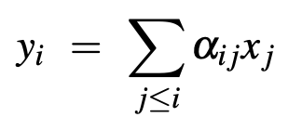
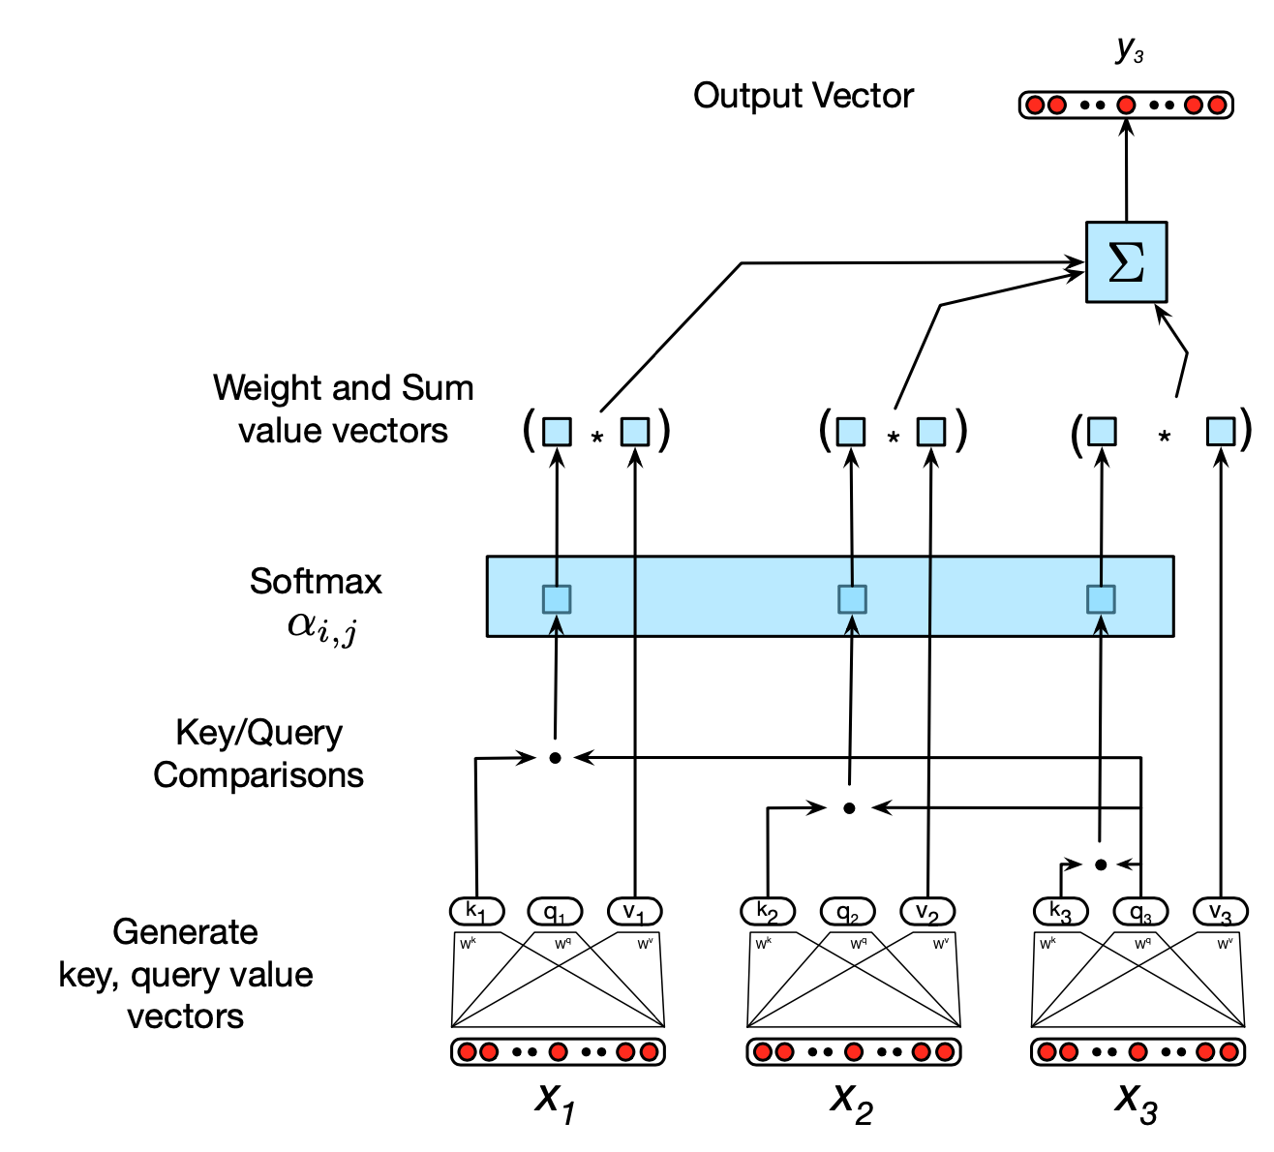
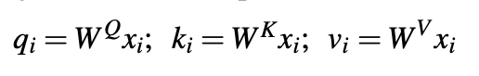
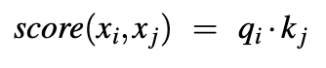
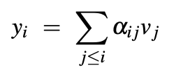
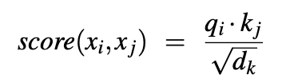
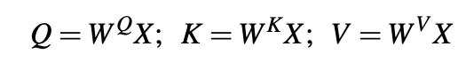

Notes:
计算y3时需要比较x1,x2,x3.
最简单的比较是内积 这里是xi xj的自相关性。Y3体现了x3和x1-x3的相关性。
然而如果到此为止就没有参数，也不存在学习的可能性了。所以需要引入3个矩阵。原始大小：1024*64.
Query: 当前考虑的词语；Key：邻居词；Value：需要输出的词语。
尺度变换以避免太大的权重—增强模型的稳定性
加入并行计算—同时计算所有的yi—因为他们是独立的

Slide 52

Transformer Blocks
a transformer block includes
self-attention layer
additional feedforward layers
residual connections
normalizing layers

Slide 53


Multi-head attention
different words in a sentence can relate to each other in many different ways
It would be difficult for a single transformer block to learn to capture all of the different kinds of parallel relations
Transformers address this issue with multi-head self-attention layers
Notes:
词语间可以存在多个角度的关联，比如动词和它的论元之间可以有句法，语义，篇章等关系。give sth to sb
单一矩阵不足以建模复杂关系。
另一个角度，引入更多的参数，更多的灵活性
通过Wo变换到原先的矩阵规模

Slide 57

Training an auto-regressive Transformer decoder as a language model

Slide 58

Autoregressive text completion with Transformers

Slide 59

Text summarization based on Transformer
Examples of articles and summaries from the CNN/Daily Mail corpus (Hermann et al., 2015), (Nallapati et al., 2016)

Slide 60

Text summarization based on Transformer

Slide 61

Encoder-Decoder with Transformers for MT

Slide 62


The transformer block for the encoder and the decoder

Slide 63

Training Data for MT and Alignment

